Slide 1
LLM Pretraining, Fine-tuning, Prompt Learning
Heng Ji
hengji@illinois.edu
Acknowledgement: Some Slides are from Dan Jurafsky, James Martin and Pengfei Liu

Slide 2
Encoders
Many varieties!
Popular: Masked Language Models (MLMs)
BERT family
Trained by predicting words from surrounding words on both sides
Are usually finetuned (trained on supervised data) for classification tasks.

Slide 3
Encoder-Decoders
Trained to map from one sequence to another
Very popular for:
machine translation (map from one language to another)
speech recognition (map from acoustics to words)

Slide 4
Decoder-only models
Also called:
Causal LLMs
Autoregressive LLMs
Left-to-right LLMs
Predict words left to right

Slide 5
Conditional Generation: Generating text conditioned on previous text!
Notes:
In predicting each next word, the model can see a representation of all the previous words

Slide 6
Many practical NLP tasks can be cast as word prediction!
Sentiment analysis: “I like Jackie Chan”
We give the language model this string: The sentiment of the sentence "I like Jackie Chan" is:
And see what word it thinks comes next:

Slide 7
Framing lots of tasks as conditional generation
QA: “Who wrote The Origin of Species”
We give the language model this string:
And see what word it thinks comes next:
And iterate:

Slide 8
Summarization
Original
Summary

Slide 9
Decoding and Sampling
This task of choosing a word to generate based on the model’s probabilities is called decoding.
The most common method for decoding in LLMs: sampling.
Sampling from a model’s distribution over words:
choose random words according to their probability assigned by the model.
After each token we’ll sample words to generate according to their probability conditioned on our previous choices,
A transformer language model will give the probability

Slide 10
Random sampling doesn't work very well
Even though random sampling mostly generate sensible, high-probable words,
There are many odd, low- probability words in the tail of the distribution
Each one is low- probability but added up they constitute a large portion of the distribution
So they get picked enough to generate weird sentences

Slide 11
Factors in word sampling: quality and diversity
Emphasize high-probability words
+ quality: more accurate, coherent, and factual,
- diversity: boring, repetitive.
Emphasize middle-probability words
+ diversity: more creative, diverse,
- quality: less factual, incoherent

Slide 12
Top-k sampling:
Choose # of words k
For each word in the vocabulary V , use the language model to compute the likelihood of this word given the context p(wt |w_{<t} )
Sort the words by likelihood, keep only the top k most probable words.
Renormalize the scores of the k words to be a legitimate probability distribution.
Randomly sample a word from within these remaining k most-probable words according to its probability.
Notes:
When k = 1, top-k sampling is identical to greedy decoding.
Setting k to a larger number than 1 leads us to sometimes select a word which is not necessarily the most probable, but is still probable enough, and whose choice results in generating more diverse but still high-enough-quality text.

Slide 13
Top-p sampling (= nucleus sampling)
Holtzman et al., 2020
Problem with top-k: k is fixed so may cover very different amounts of probability mass in different situations
Idea: Instead, keep the top p percent of the probability mass
Given a distribution P(w_{t} |w_{<t} ), the top-p vocabulary V ( p) is the smallest set of words such that
Notes:
sometimes the top k words will be very likely and include most of the probability mass, but other times flatter and the top 10 words will only include a small part of the probability mass.

Slide 14
Temperature sampling
Reshape the distribution instead of truncating it
Intuition from thermodynamics,
a system at high temperature is flexible and can explore many possible states,
a system at lower temperature is likely to explore a subset of lower energy (better) states.
In low-temperature sampling, (τ ≤ 1) we smoothly
increase the probability of the most probable words
decrease the probability of the rare words.

Slide 15
Temperature sampling
Divide the logit by a temperature parameter τ before passing it through the softmax.
Instead of
We do

Slide 16
Temperature sampling
0 ≤ τ ≤ 1
Why does this work?
When τ is close to 1 the distribution doesn’t change much.
The lower τ is, the larger the scores being passed to the softmax
Softmax pushes high values toward 1 and low values toward 0.
Large inputs pushes high-probability words higher and low probability word lower, making the distribution more greedy.
As τ approaches 0, the probability of most likely word approaches 1
Notes:
(dividing by a smaller fraction τ ≤ 1 results in making each score larger).

Slide 17
Pretraining
The big idea that underlies all the amazing performance of language models
First pretrain a transformer model on enormous amounts of text
Then apply it to new tasks.

Slide 18
Self-supervised training algorithm
We just train them to predict the next word!
Take a corpus of text
At each time step t
ask the model to predict the next word
train the model using gradient descent to minimize the error in this prediction
"Self-supervised" because it just uses the next word as the label!

Slide 19
Intuition of language model training: loss
Same loss function: cross-entropy loss
We want the model to assign a high probability to true word w
= want loss to be high if the model assigns too low a probability to w
CE Loss: The negative log probability that the model assigns to the true next word w
If the model assigns too low a probability to w
We move the model weights in the direction that assigns a higher probability to w

Slide 20
Cross-entropy loss for language modeling
CE loss: difference between the correct probability distribution and the predicted distribution
The correct distribution y_{t} knows the next word, so is 1 for the actual next word and 0 for the others.
So in this sum, all terms get multiplied by zero except one: the logp the model assigns to the correct next word, so:

Slide 21
Training a transformer language model

Slide 22
LLMs are mainly trained on the web
Common crawl, snapshots of the entire web produced by the non- profit Common Crawl with billions of pages
Colossal Clean Crawled Corpus (C4; Raffel et al. 2020), 156 billion tokens of English, filtered
What's in it? Mostly patent text documents, Wikipedia, and news sites

Slide 23
The Pile: a pretraining corpus
academics
web
books
dialog

Slide 24
Filtering for quality and safety
Quality is subjective
Many LLMs attempt to match Wikipedia, books, particular websites
Need to remove boilerplate, adult content
Deduplication at many levels (URLs, documents, even lines)
Safety also subjective
Toxicity detection is important, although that has mixed results
Can mistakenly flag data written in dialects like African American English

Slide 25
Finetuning for daptation to new domains
What happens if we need our LLM to work well on a domain it didn't see in pretraining?
Perhaps some specific medical or legal domain?
Or maybe a multilingual LM needs to see more data on some language that was rare in pretraining?

Slide 26
Finetuning

Slide 27
"Finetuning" means 4 different things
We'll discuss 1 here, and 3 in later lectures
In all four cases, finetuning means:
taking a pretrained model and further adapting some or all of its parameters to some new data
Notes:
But they differ on exactly which parameters get updated.

Slide 28
1. Finetuning as "continued pretraining" on new data
Further train all the parameters of model on new data
using the same method (word prediction) and loss function (cross-entropy loss) as for pretraining.
as if the new data were at the tail end of the pretraining data
Hence sometimes called continued pretraining

Slide 29
Evaluating LLMs: Perplexity
Just as for n-gram grammars, we use perplexity to measure how well the LM predicts unseen text
The perplexity of a model θ on an unseen test set is the inverse probability that θ assigns to the test set, normalized by the test set length.
For a test set of n tokens w_{1:n} the perplexity is :

Slide 30
Perplexity
The higher the probability of the word sequence, the lower the perplexity.
Thus the lower the perplexity of a model on the data, the better the model.
Minimizing perplexity is the same as maximizing probability
Also: perplexity is sensitive to length/tokenization so best used when comparing LMs that use the same tokenizer.

Slide 31
Parameter-Efficient Finetuning
Adapting to a new domain by continued pretraining (finetuning) is a problem with huge LLMs.
Enormous numbers of parameters to train
Each pass of batch gradient descent has to backpropagate through many many huge layers.
Expensive in processing power, in memory, and in time.
Instead, parameter-efficient fine tuning (PEFT)
Efficiently select a subset of parameters to update when finetuning.
E.g., freeze some of the parameters (don’t change them),
And only update some a few parameters.

Slide 32
LoRA (Low-Rank Adaptation)
Transformers have many dense matrix multiply layers
Like W^{Q}, W^{K}, W^{V}, W^{O} layers in attention
Instead of updating these layers during finetuning,
Freeze these layers
Update a low-rank approximation with fewer parameters.

Slide 33
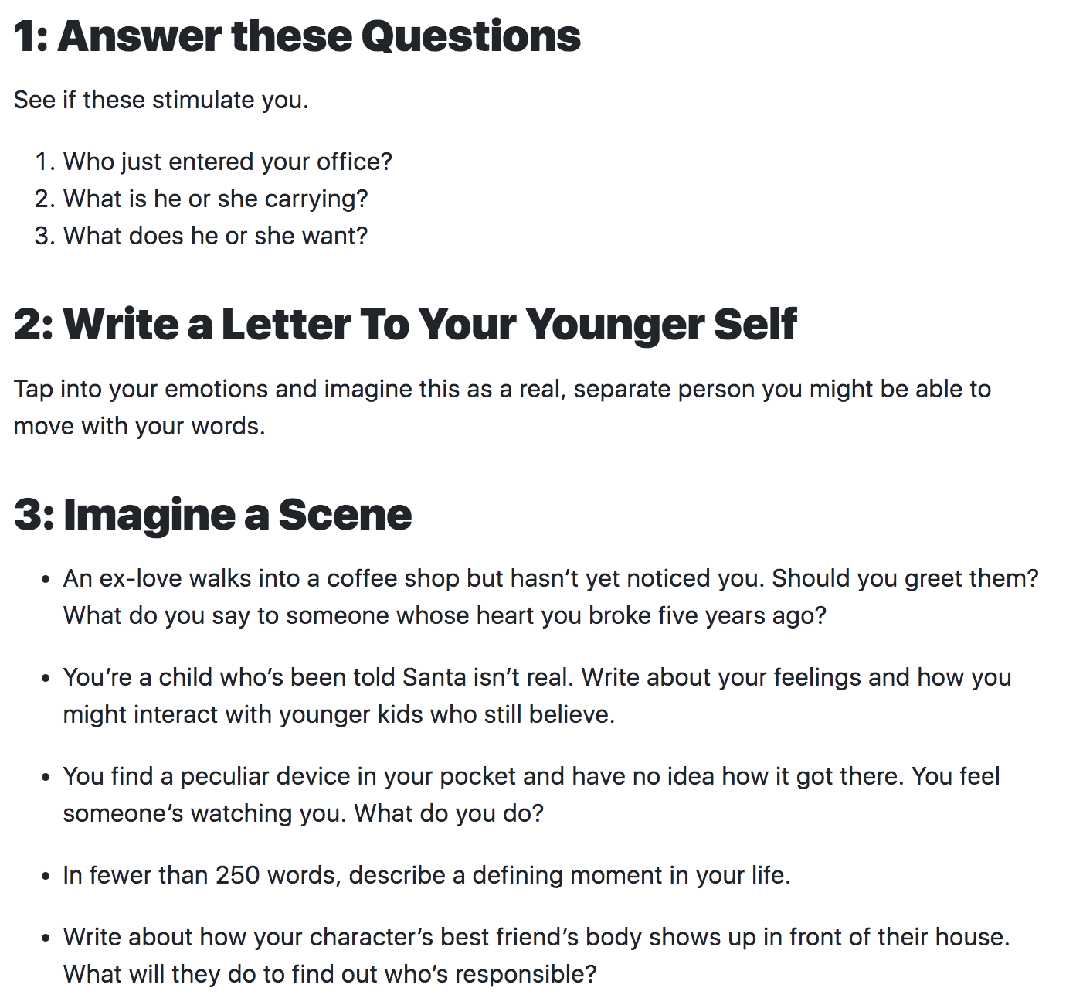
We Often do Prompt based Writing Exercise

Slide 34
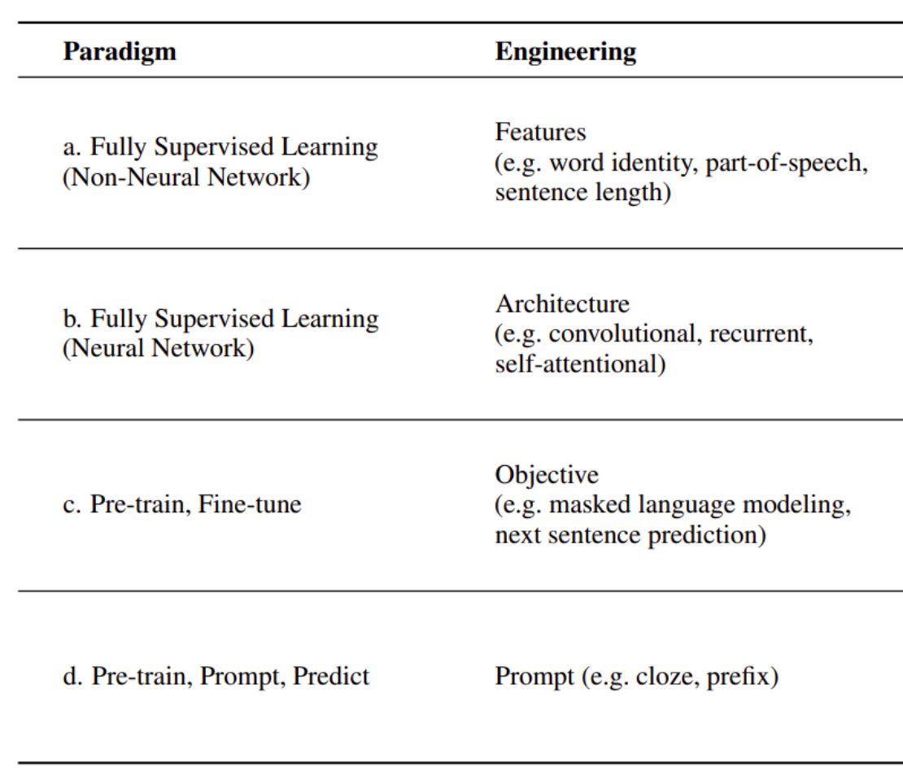
Some NLP Paradigm Shift
34
Notes:
Change low resource IL to a language which is not in wikipedia
Word-level: from bi-lingual dicts and alignment; structure-level comes from wals; multi-level alignment

Slide 35
Why Do We need Prompt Learning for LLMs?
Mostly because it’s one of the few ways we can ‘probe’ knowledge hidden in these “black-box” LLMs
Unstructured Multimodal Multilingual Data
Large Neural Models
Elicit Explicit Symbolic Knowledge
Knowledge Localization and Generalization
Knowledge Augmentation and Distillation
Knowledge Patching and Fusion
Knowledge Extraction
External Symbolic Knowledge
Background Knowledge
Domain-Specific Knowledge
World Knowledge
Structured Knowledge
Task-Specific Knowledge
Notes:
XXX check ideas in the knowledge section in position paper
XXX
Zi xue cheng cai
Self updating
Self correction
Knowledge generalization

Slide 36
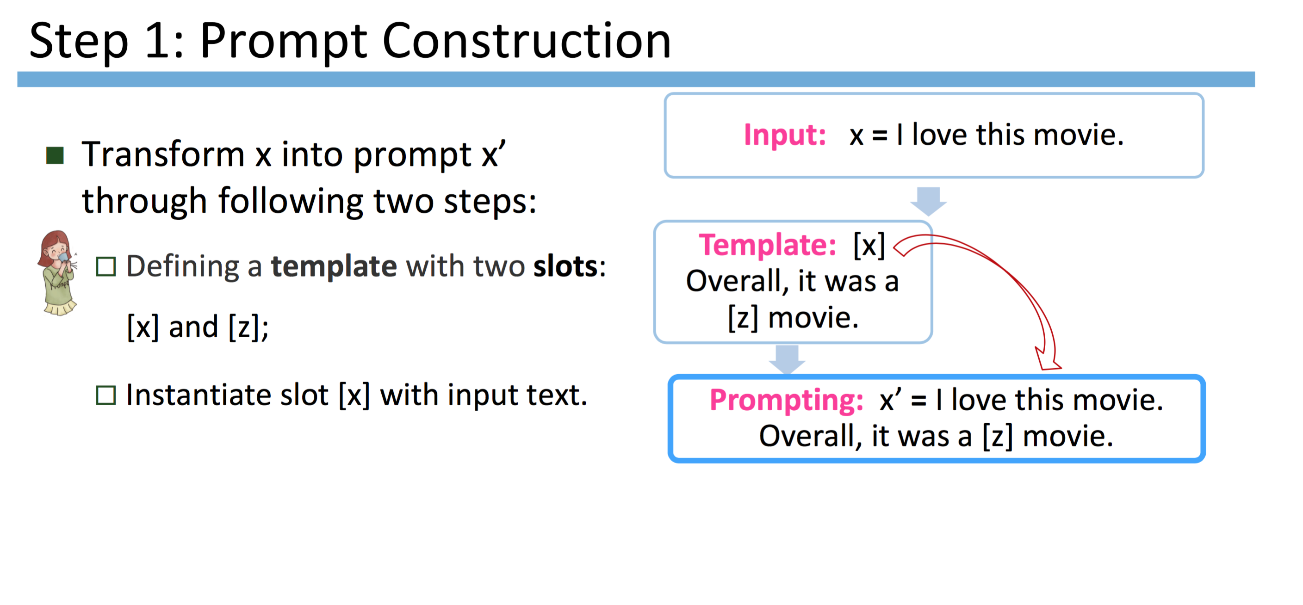
Basic Prompt Learning Framework
36
Notes:
Change low resource IL to a language which is not in wikipedia
Word-level: from bi-lingual dicts and alignment; structure-level comes from wals; multi-level alignment

Slide 37
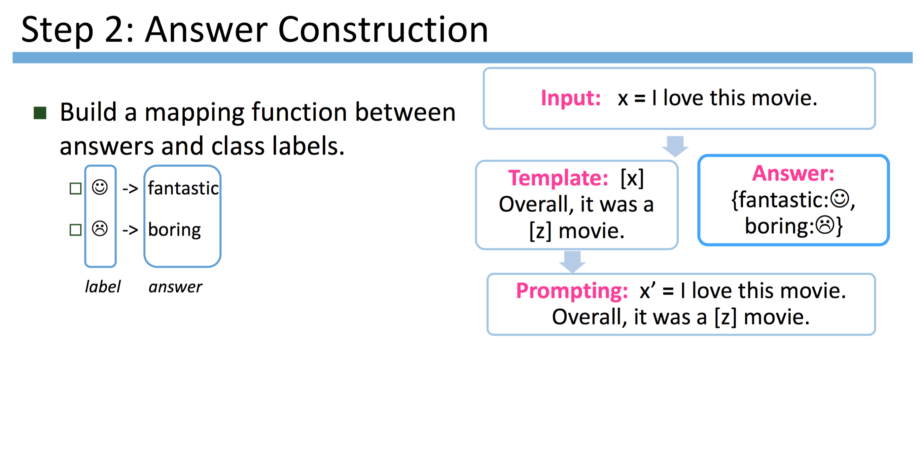
37
Notes:
Change low resource IL to a language which is not in wikipedia
Word-level: from bi-lingual dicts and alignment; structure-level comes from wals; multi-level alignment

Slide 38
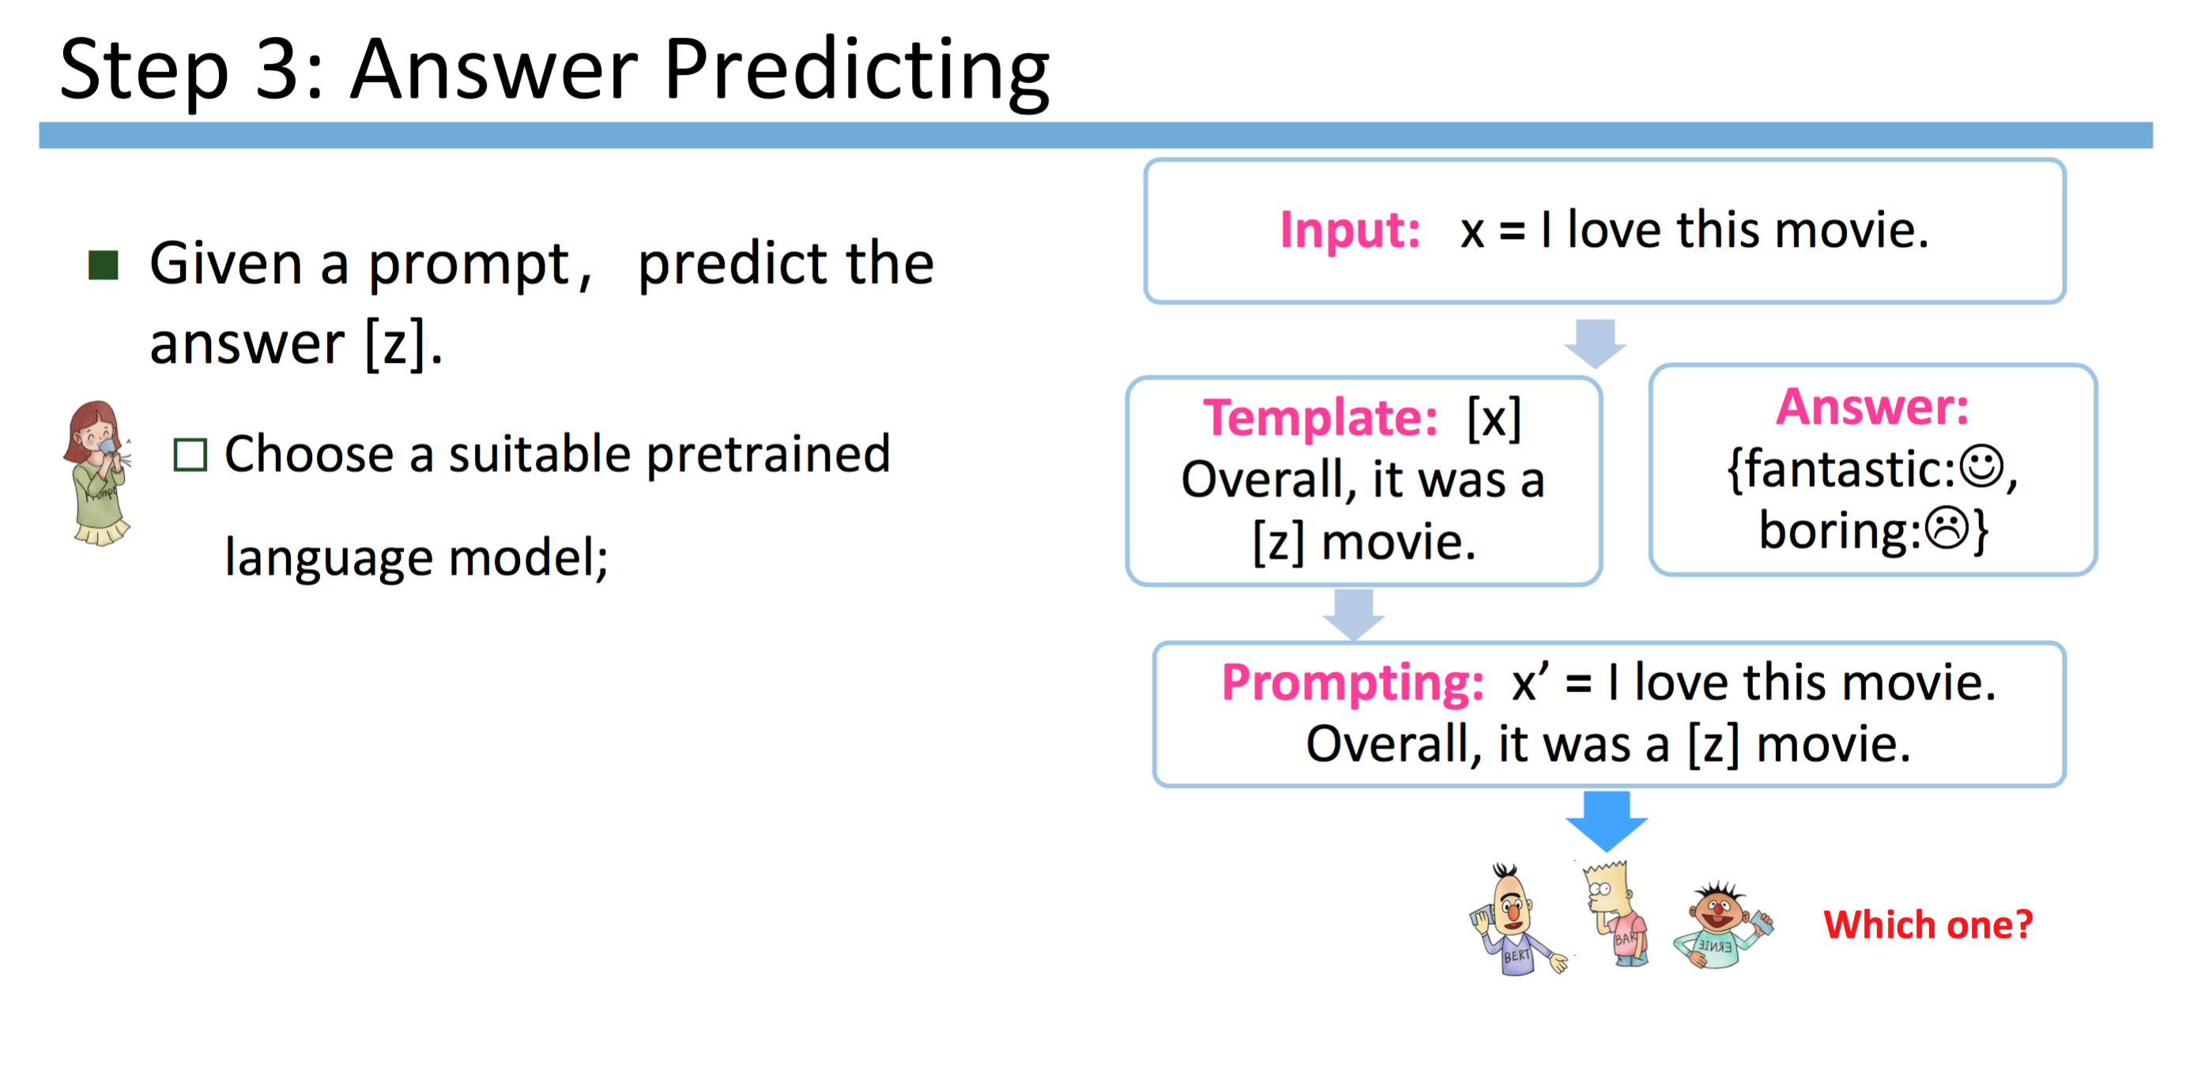
38
Notes:
Change low resource IL to a language which is not in wikipedia
Word-level: from bi-lingual dicts and alignment; structure-level comes from wals; multi-level alignment

Slide 39
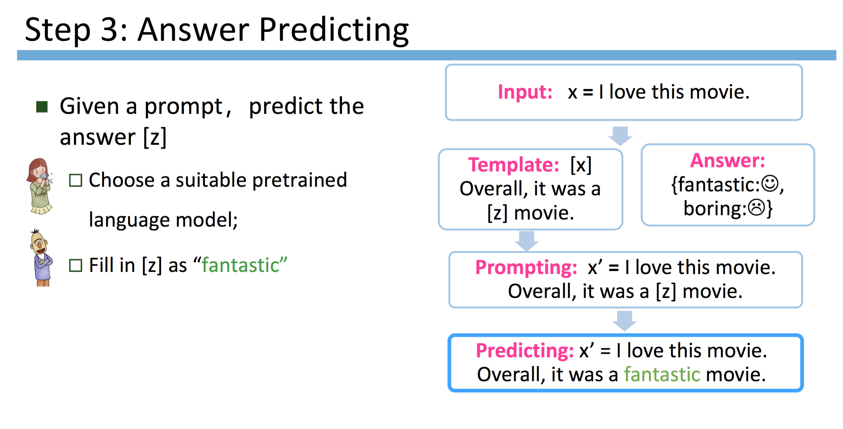
39
Notes:
Change low resource IL to a language which is not in wikipedia
Word-level: from bi-lingual dicts and alignment; structure-level comes from wals; multi-level alignment

Slide 40
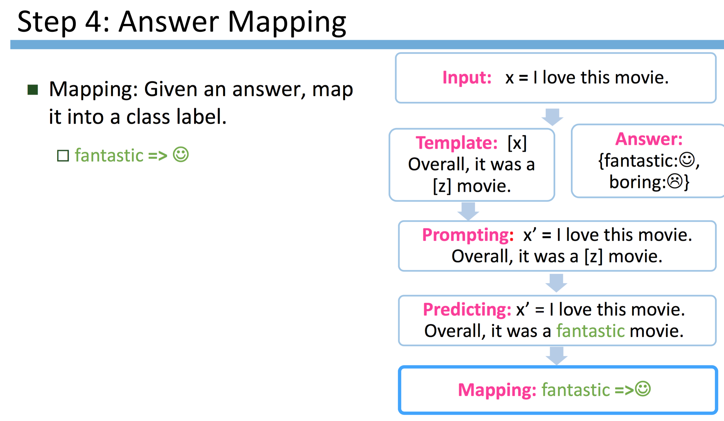
40
Notes:
Change low resource IL to a language which is not in wikipedia
Word-level: from bi-lingual dicts and alignment; structure-level comes from wals; multi-level alignment

Slide 41
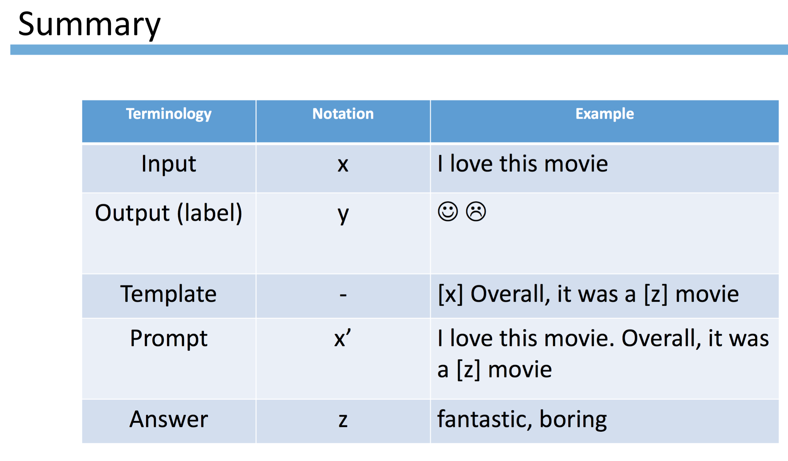
41
Notes:
Change low resource IL to a language which is not in wikipedia
Word-level: from bi-lingual dicts and alignment; structure-level comes from wals; multi-level alignment

Slide 42
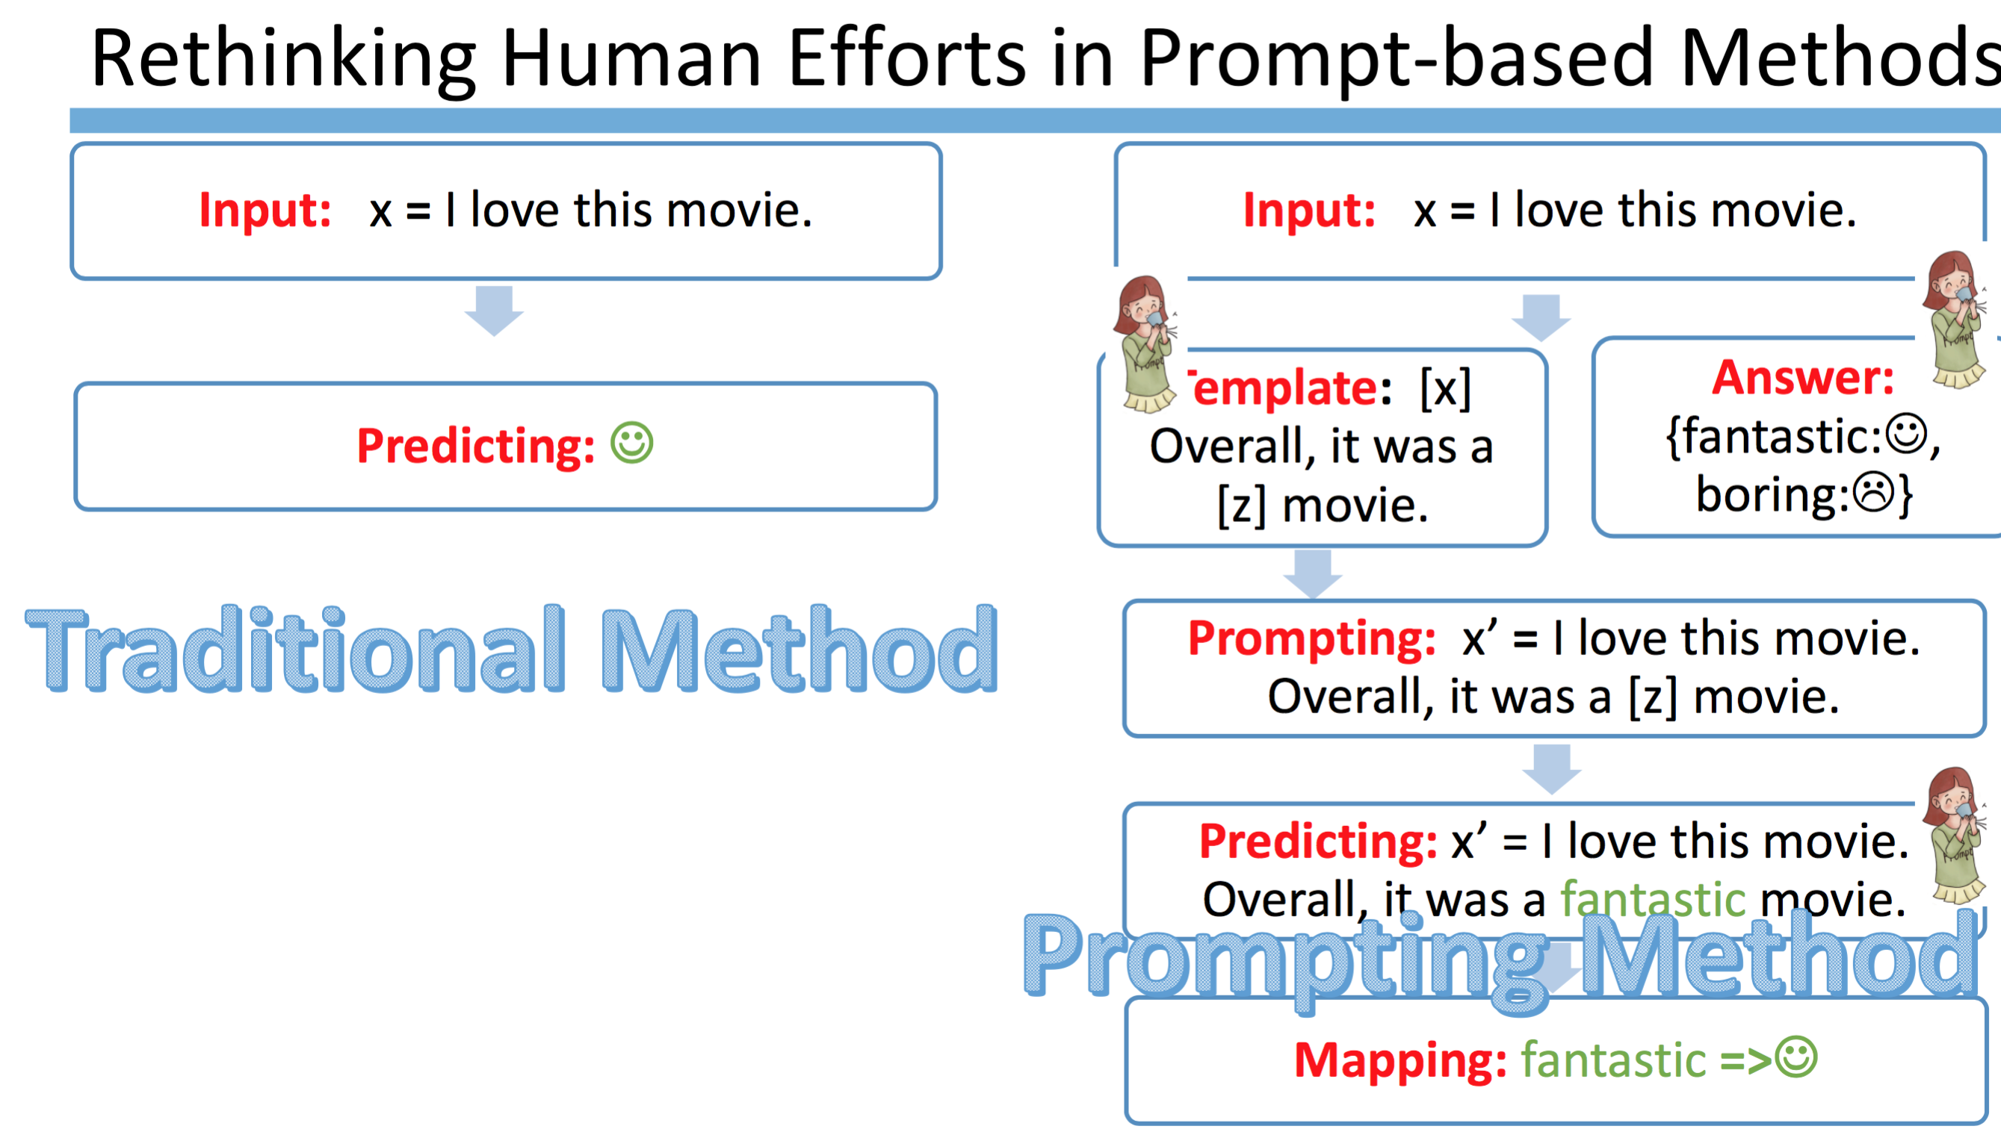
42
Notes:
Change low resource IL to a language which is not in wikipedia
Word-level: from bi-lingual dicts and alignment; structure-level comes from wals; multi-level alignment

Slide 43
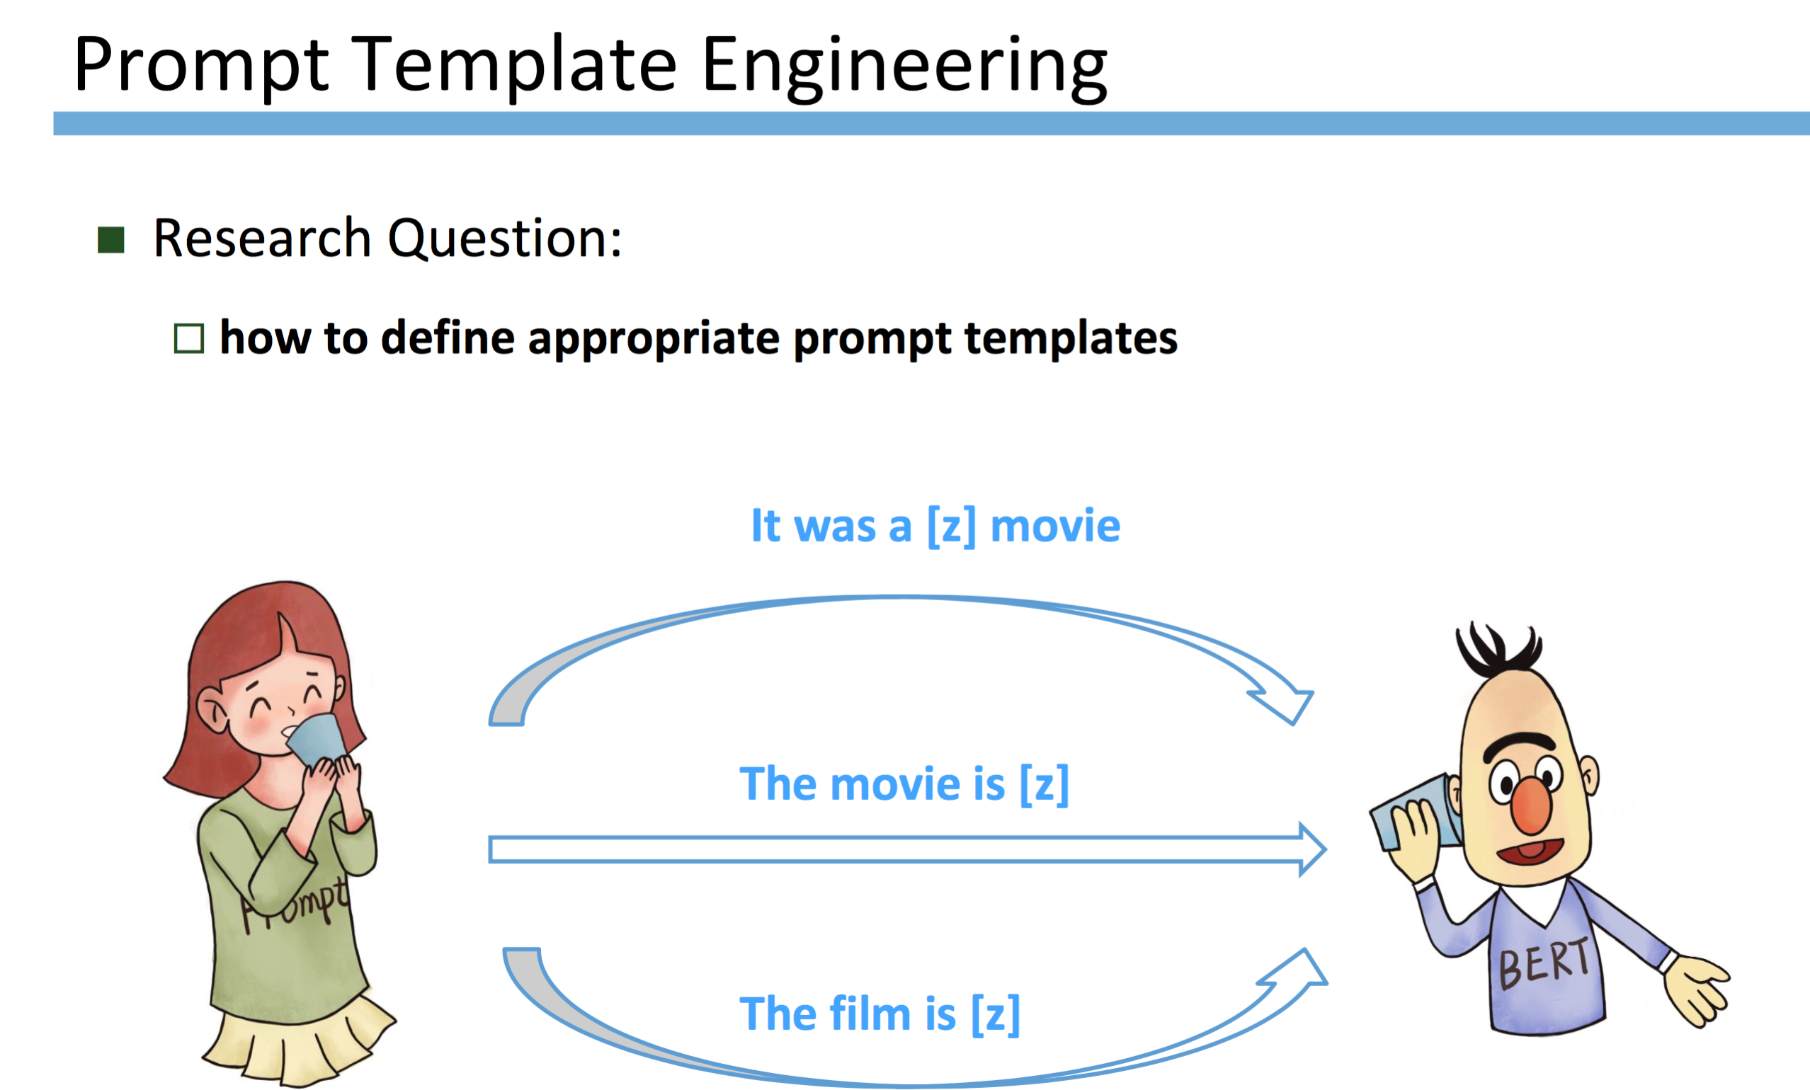
43
Notes:
Change low resource IL to a language which is not in wikipedia
Word-level: from bi-lingual dicts and alignment; structure-level comes from wals; multi-level alignment

Slide 44
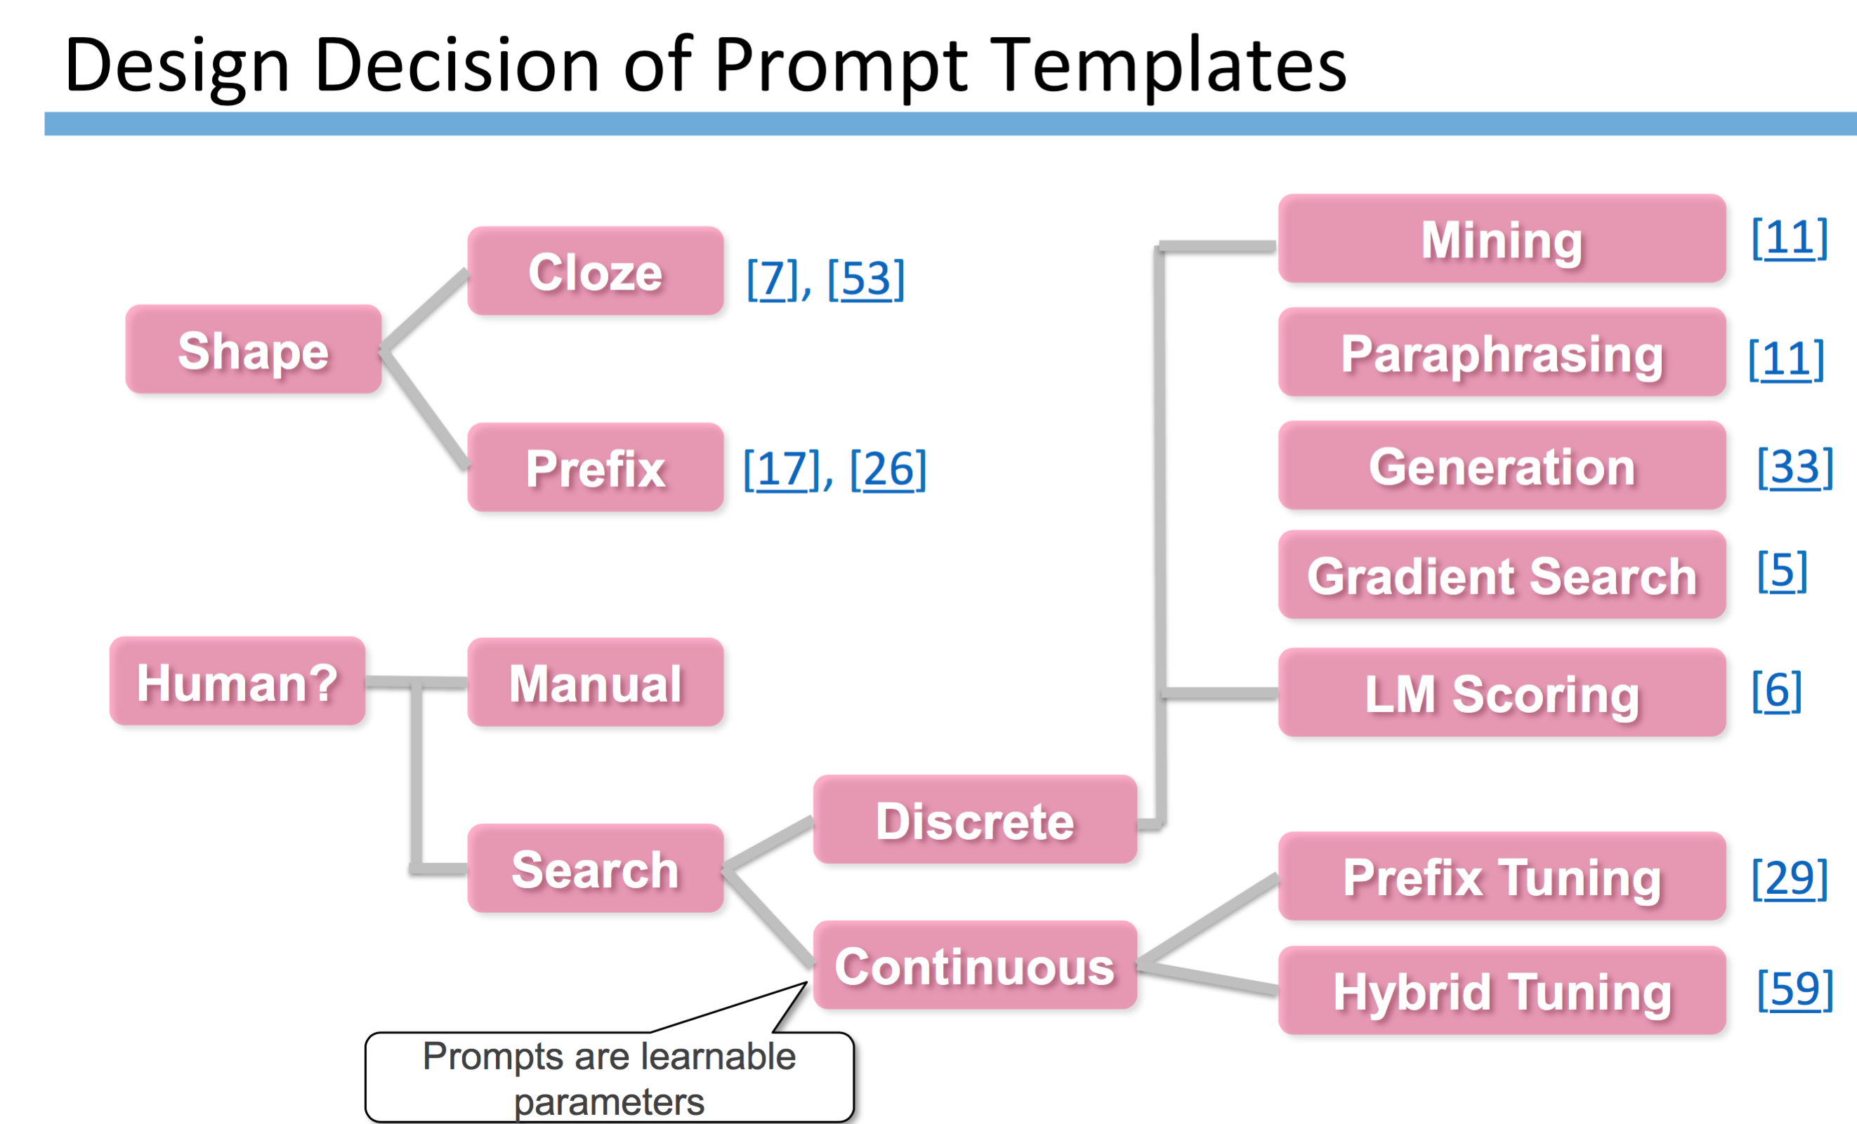
44
Notes:
Change low resource IL to a language which is not in wikipedia
Word-level: from bi-lingual dicts and alignment; structure-level comes from wals; multi-level alignment

Slide 45
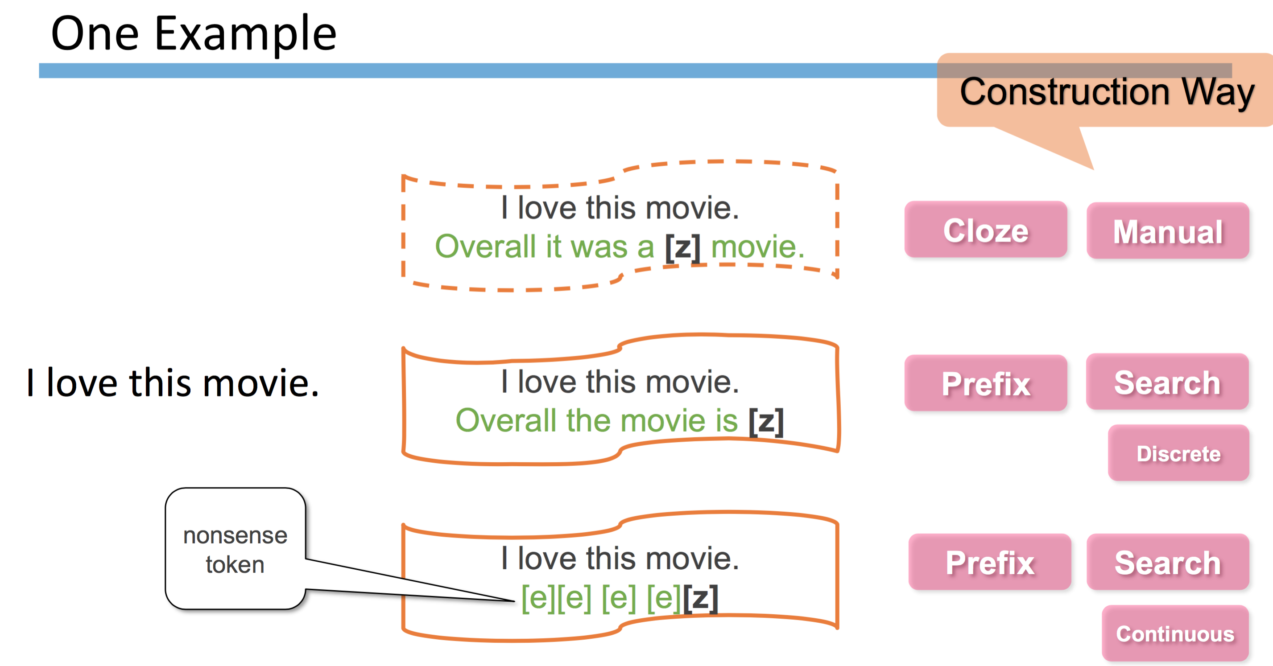
45
Notes:
Change low resource IL to a language which is not in wikipedia
Word-level: from bi-lingual dicts and alignment; structure-level comes from wals; multi-level alignment

Slide 46
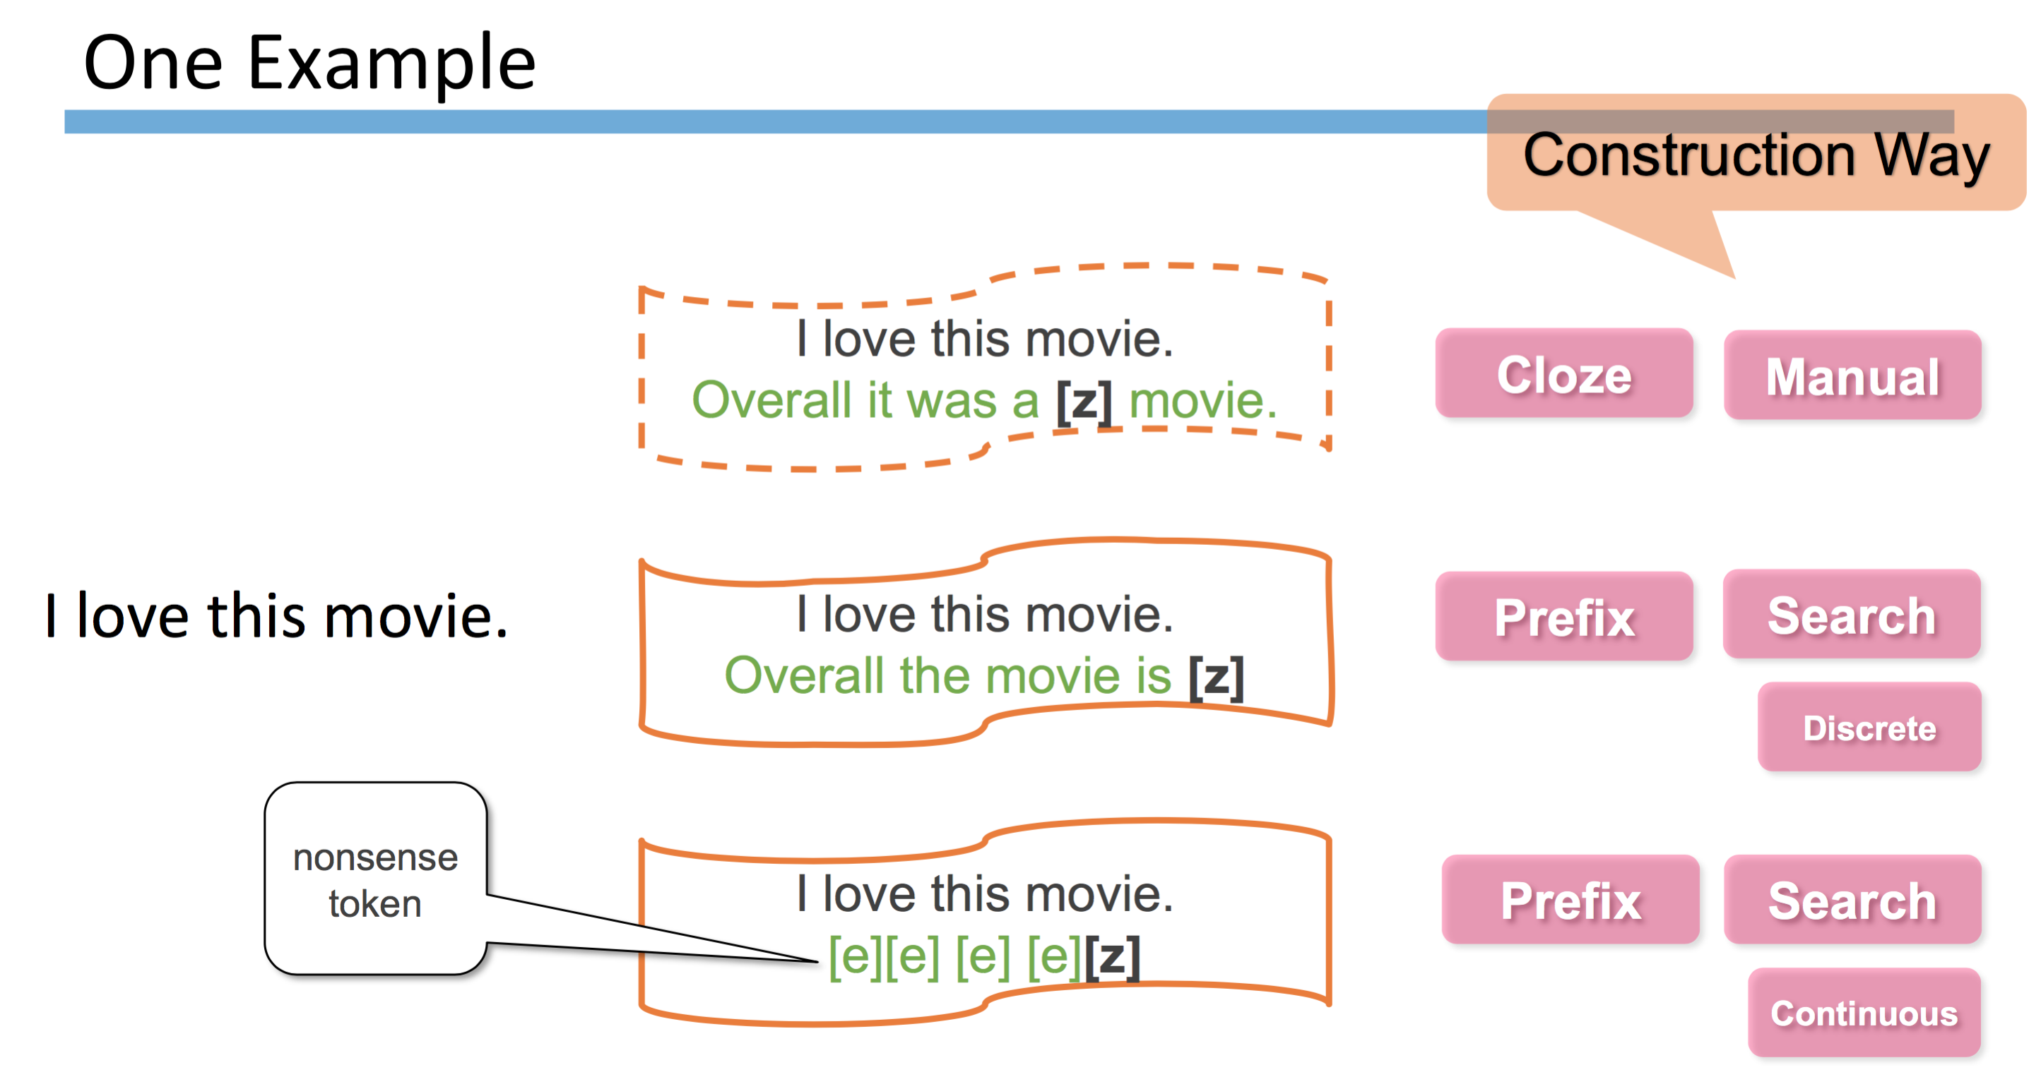
46
Notes:
Change low resource IL to a language which is not in wikipedia
Word-level: from bi-lingual dicts and alignment; structure-level comes from wals; multi-level alignment

Slide 47
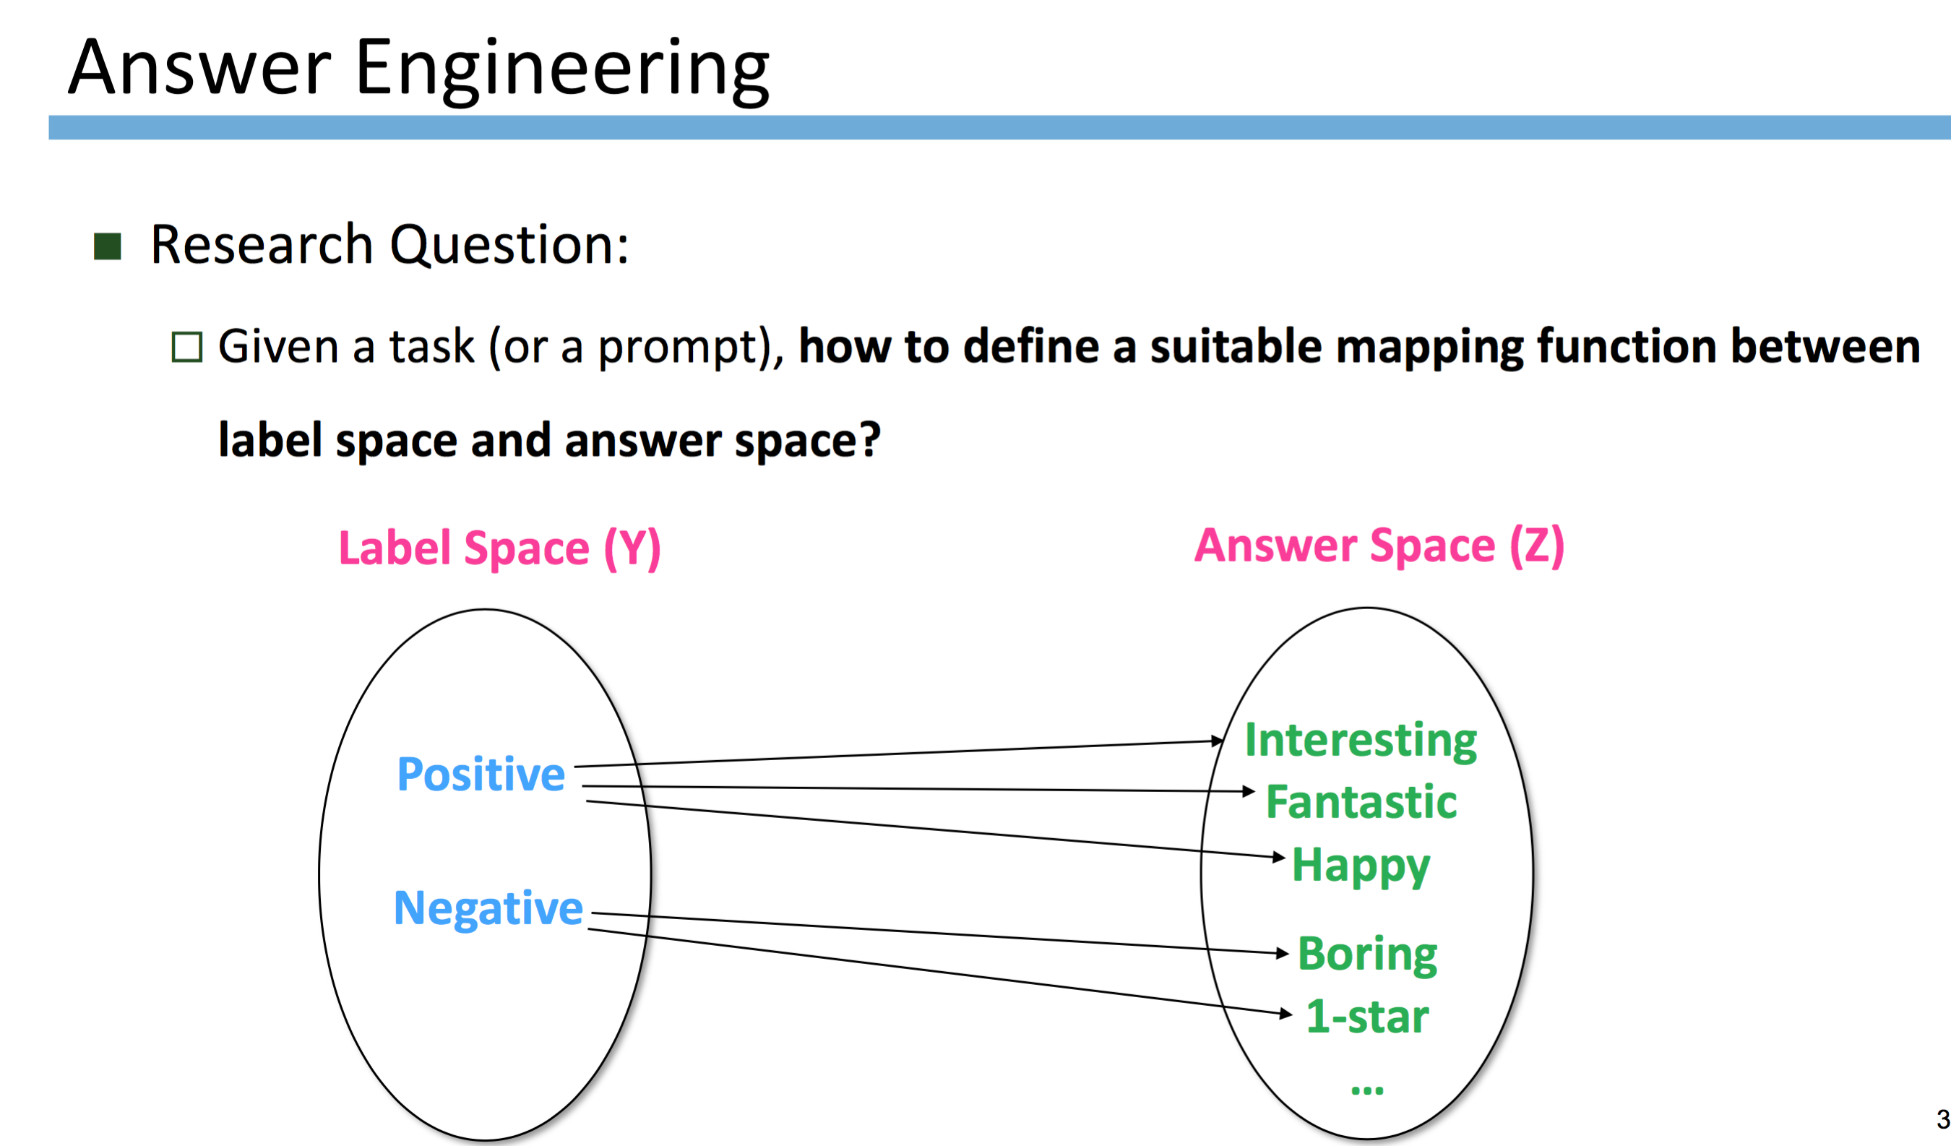
47
Notes:
Change low resource IL to a language which is not in wikipedia
Word-level: from bi-lingual dicts and alignment; structure-level comes from wals; multi-level alignment

Slide 48
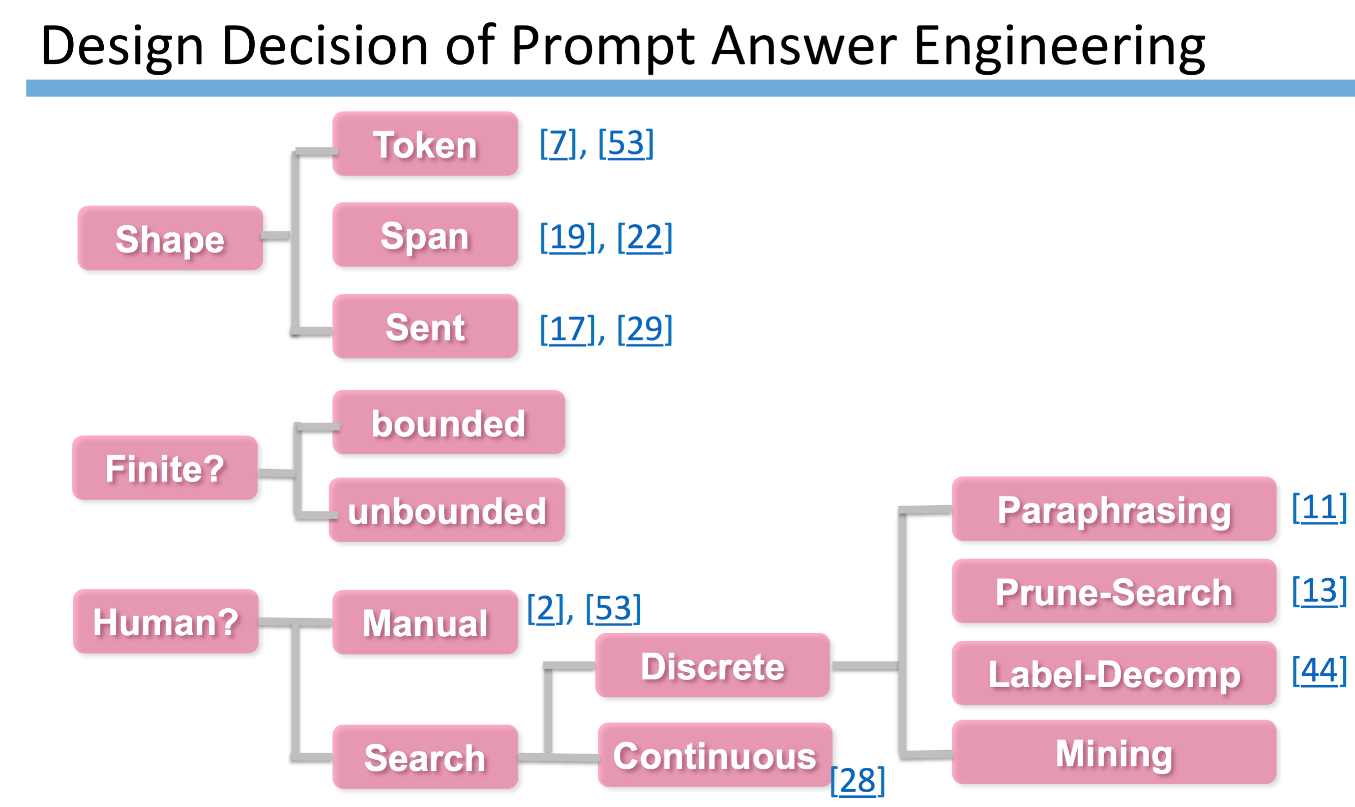
48
Notes:
Change low resource IL to a language which is not in wikipedia
Word-level: from bi-lingual dicts and alignment; structure-level comes from wals; multi-level alignment

Slide 49
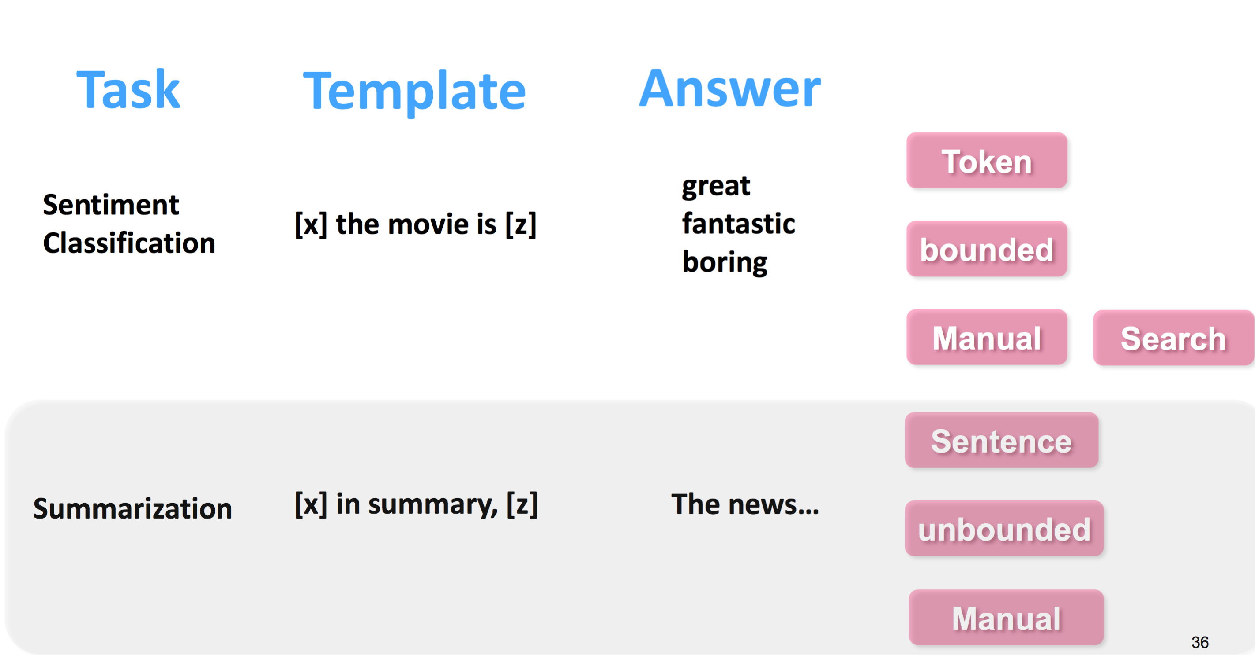
49
Notes:
Change low resource IL to a language which is not in wikipedia
Word-level: from bi-lingual dicts and alignment; structure-level comes from wals; multi-level alignment

Slide 50
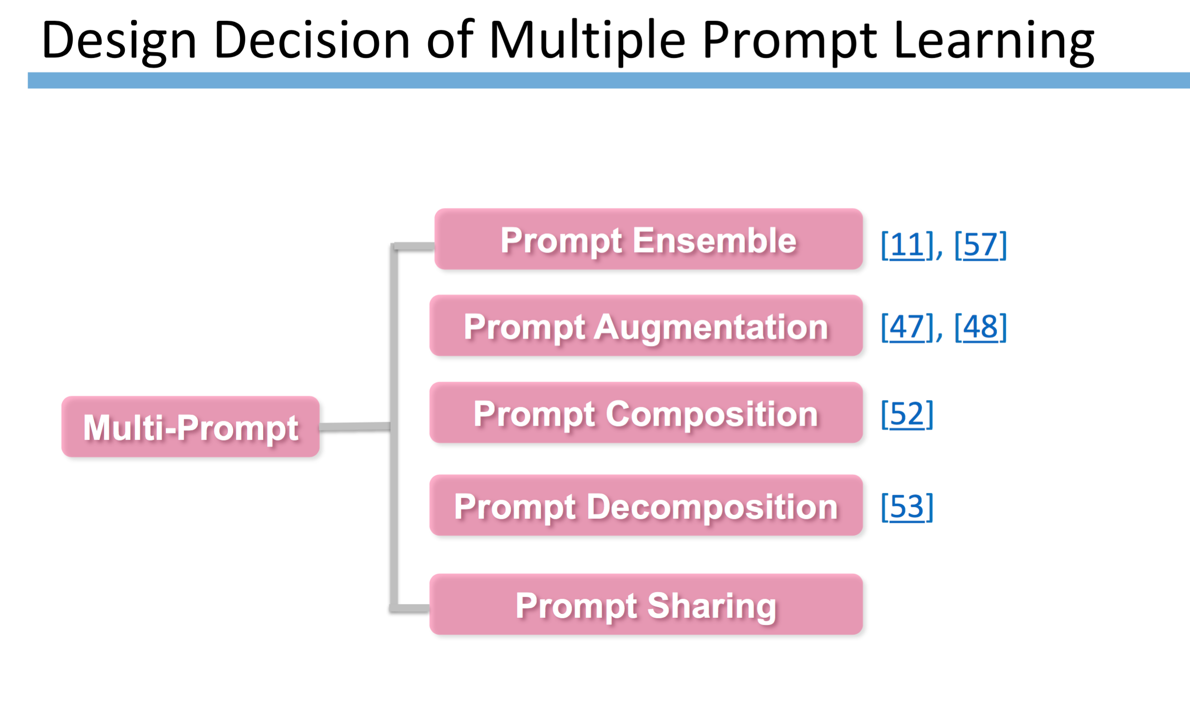
50
Notes:
Change low resource IL to a language which is not in wikipedia
Word-level: from bi-lingual dicts and alignment; structure-level comes from wals; multi-level alignment

Slide 51
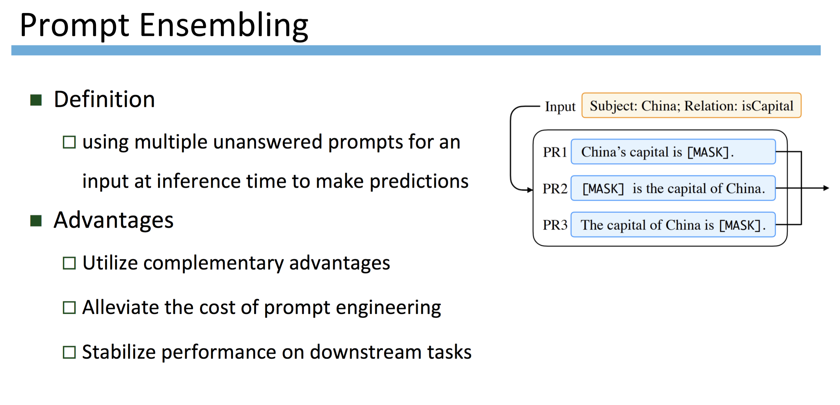
51
Notes:
Change low resource IL to a language which is not in wikipedia
Word-level: from bi-lingual dicts and alignment; structure-level comes from wals; multi-level alignment

Slide 52
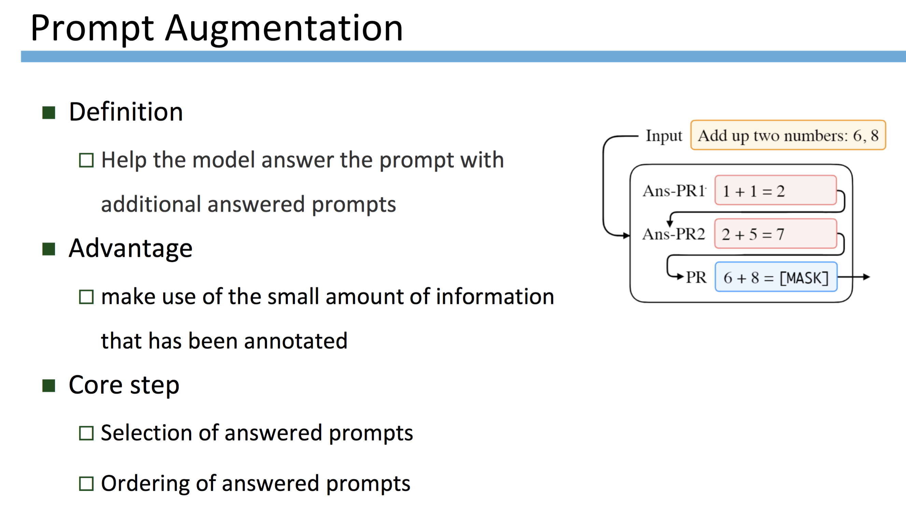
52
Notes:
Change low resource IL to a language which is not in wikipedia
Word-level: from bi-lingual dicts and alignment; structure-level comes from wals; multi-level alignment

Slide 53
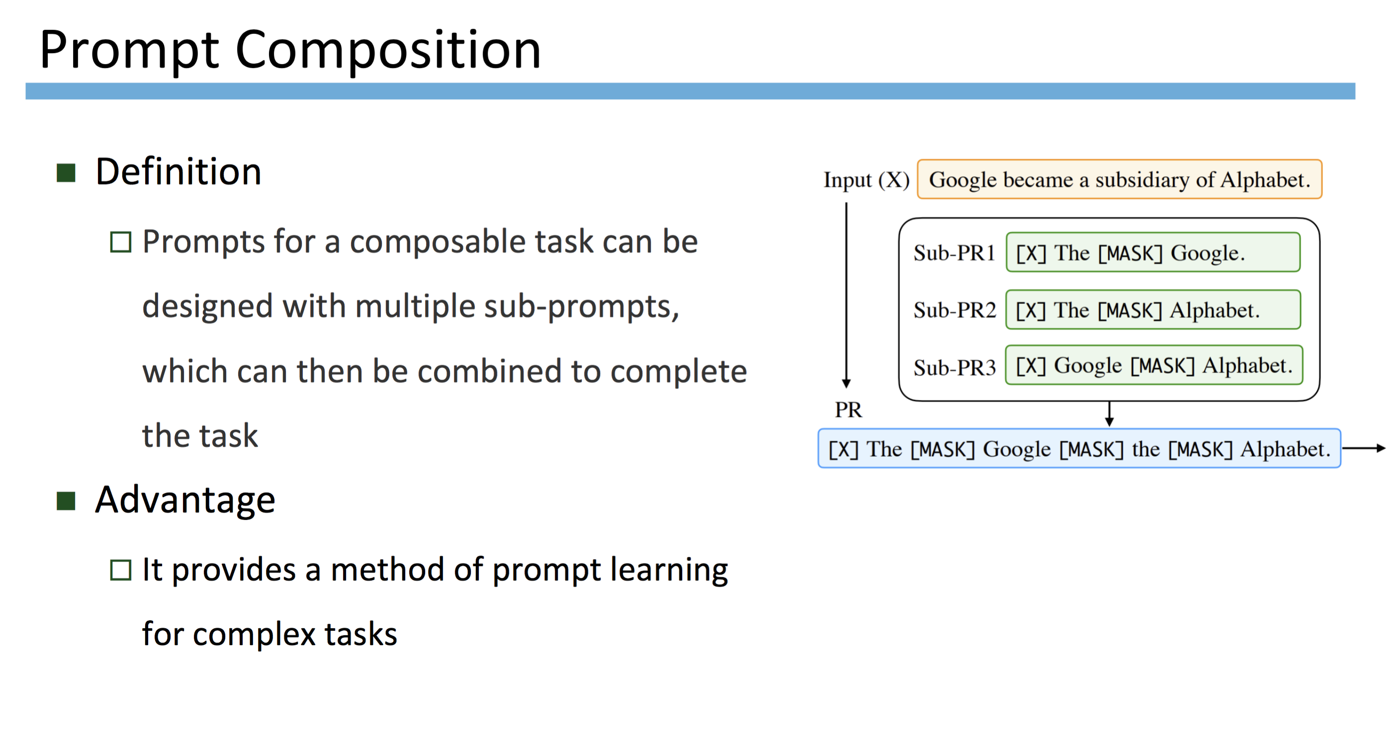
53
Notes:
Change low resource IL to a language which is not in wikipedia
Word-level: from bi-lingual dicts and alignment; structure-level comes from wals; multi-level alignment

Slide 54
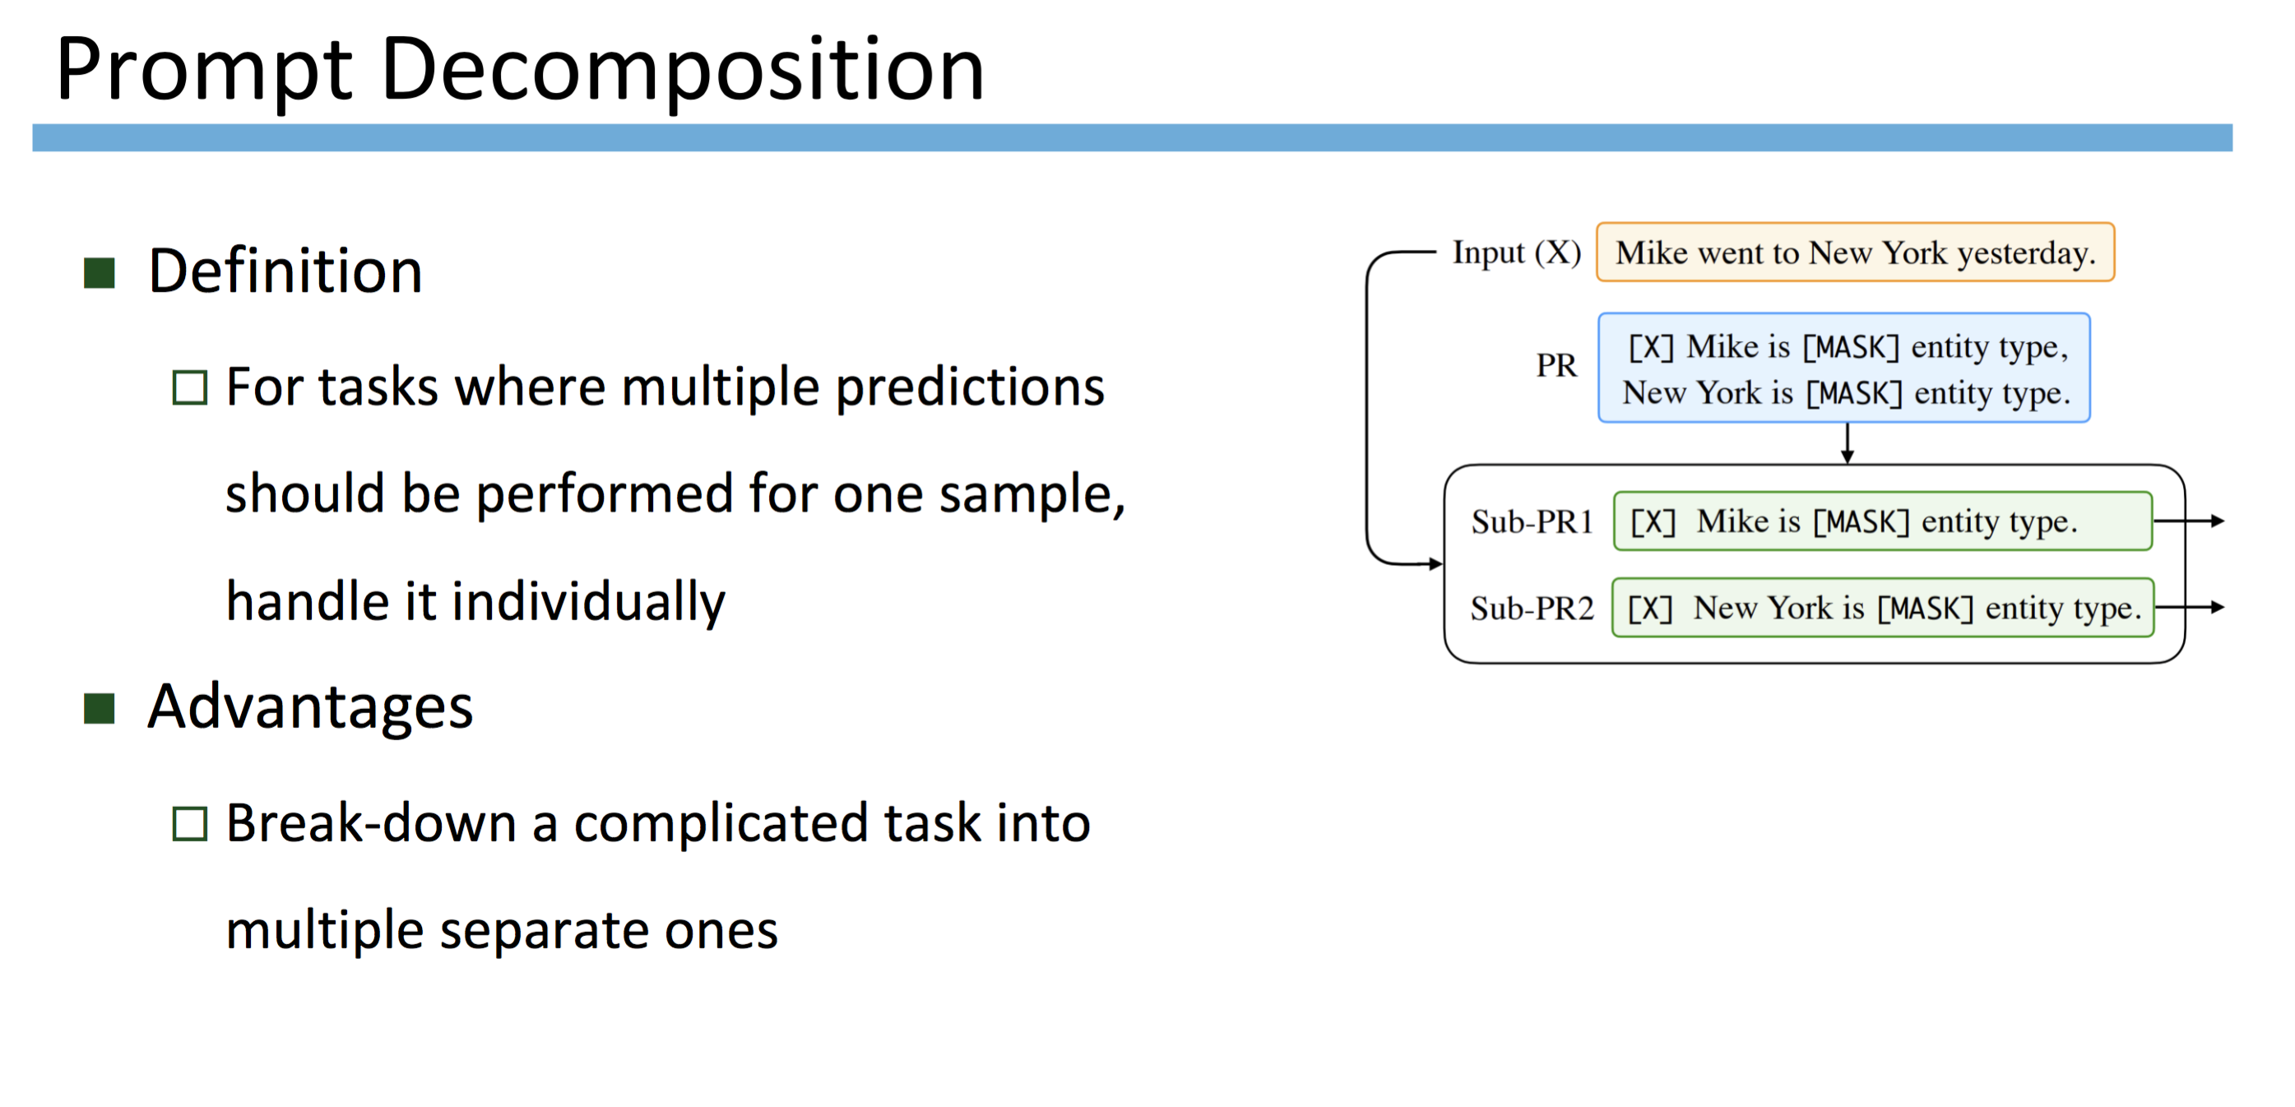
54
Notes:
Change low resource IL to a language which is not in wikipedia
Word-level: from bi-lingual dicts and alignment; structure-level comes from wals; multi-level alignment

Slide 55
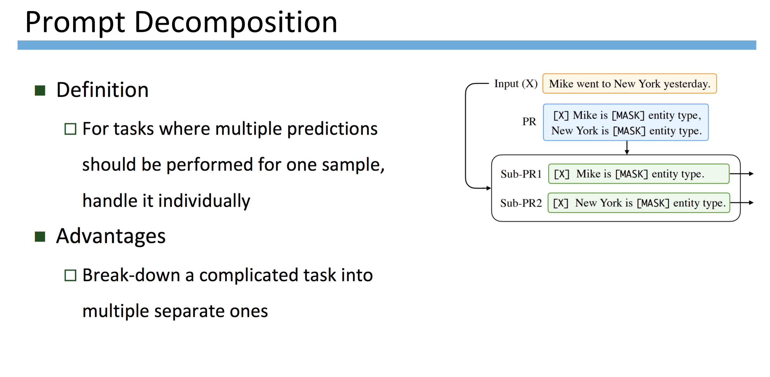
55
Notes:
Change low resource IL to a language which is not in wikipedia
Word-level: from bi-lingual dicts and alignment; structure-level comes from wals; multi-level alignment

Slide 56
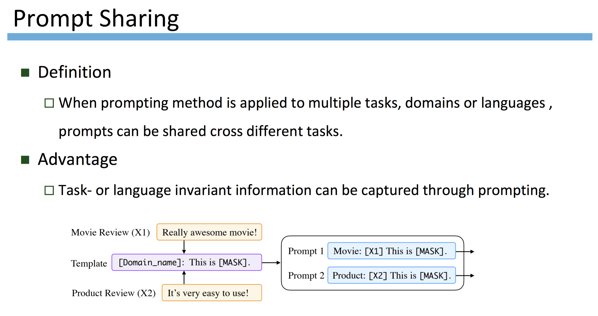
56
Notes:
Change low resource IL to a language which is not in wikipedia
Word-level: from bi-lingual dicts and alignment; structure-level comes from wals; multi-level alignment

Slide 57
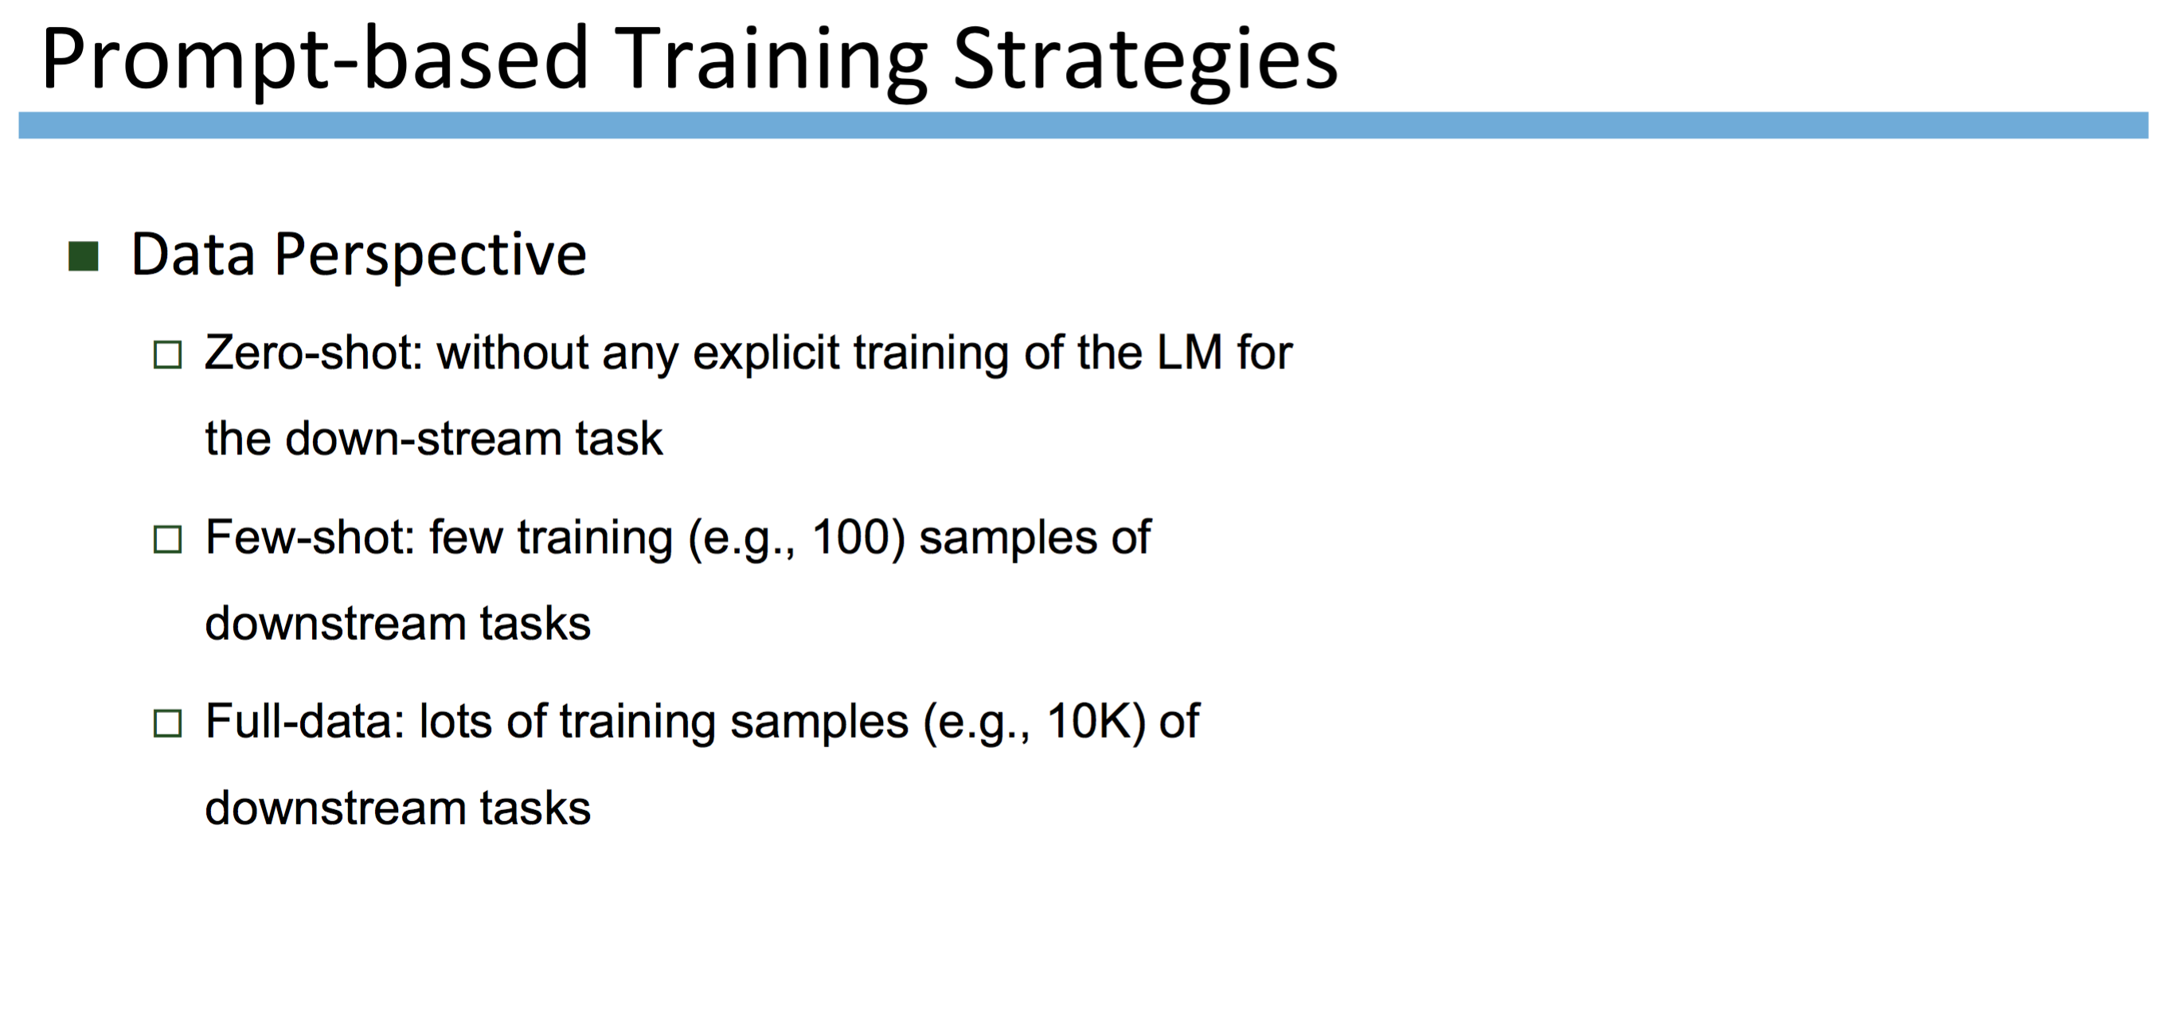
57
Notes:
Change low resource IL to a language which is not in wikipedia
Word-level: from bi-lingual dicts and alignment; structure-level comes from wals; multi-level alignment

Slide 58
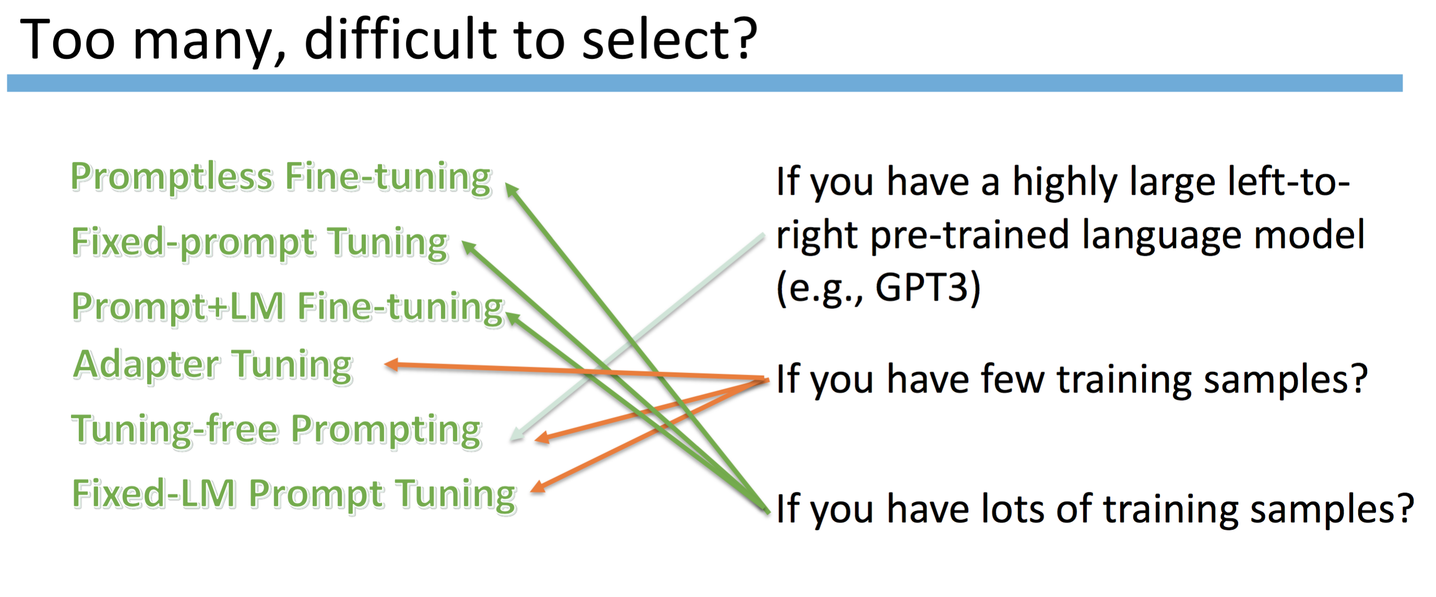
58
Notes:
Change low resource IL to a language which is not in wikipedia
Word-level: from bi-lingual dicts and alignment; structure-level comes from wals; multi-level alignment

Slide 59
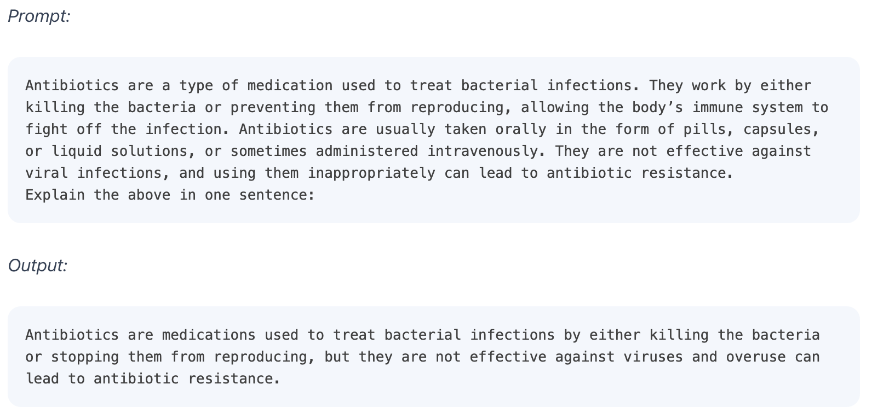
Example 1: Text Summarization
59
Notes:
Change low resource IL to a language which is not in wikipedia
Word-level: from bi-lingual dicts and alignment; structure-level comes from wals; multi-level alignment

Slide 60
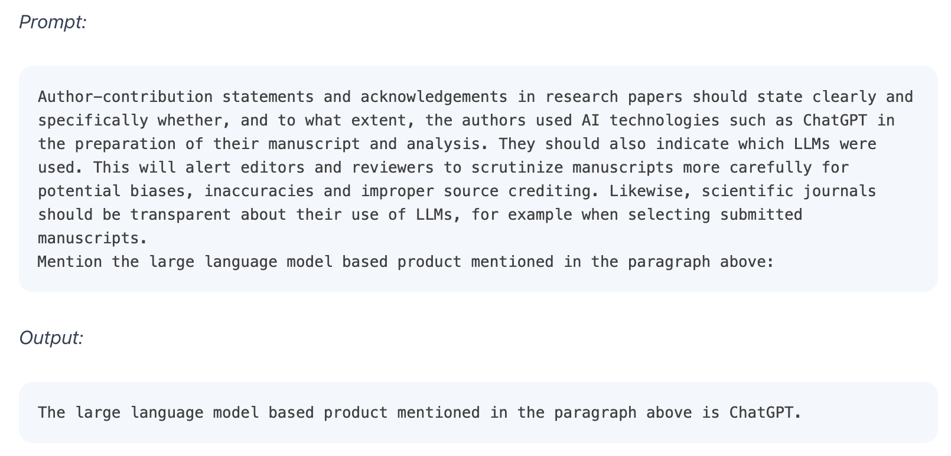
Example 2: Information Extraction
60
Notes:
Change low resource IL to a language which is not in wikipedia
Word-level: from bi-lingual dicts and alignment; structure-level comes from wals; multi-level alignment

Slide 61
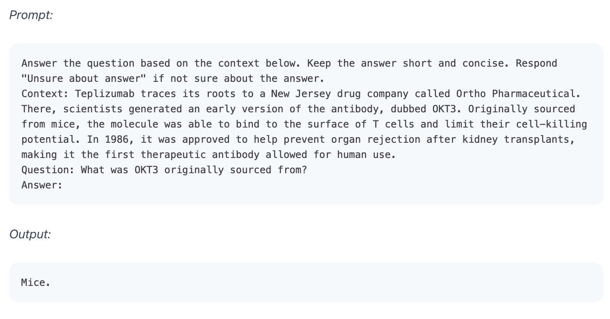
Example 3: Question Answering
61
Notes:
Change low resource IL to a language which is not in wikipedia
Word-level: from bi-lingual dicts and alignment; structure-level comes from wals; multi-level alignment

Slide 62
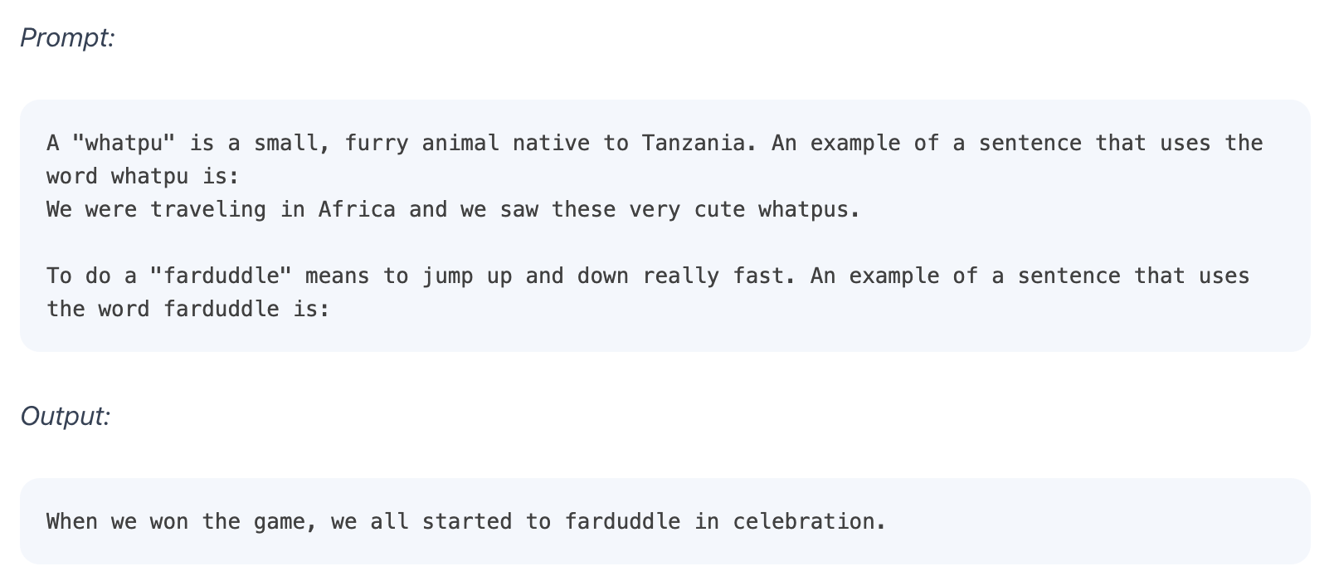
Few-Shot Prompting Examples
62
Notes:
Change low resource IL to a language which is not in wikipedia
Word-level: from bi-lingual dicts and alignment; structure-level comes from wals; multi-level alignment

Slide 63
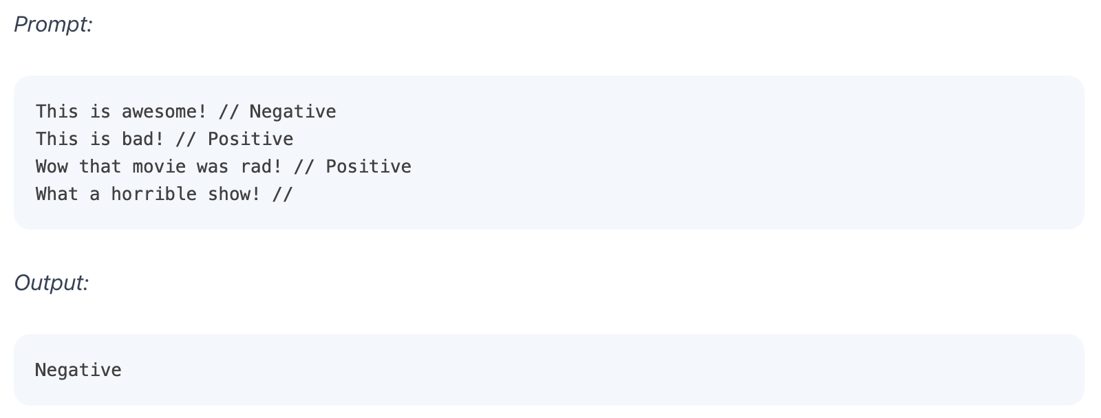
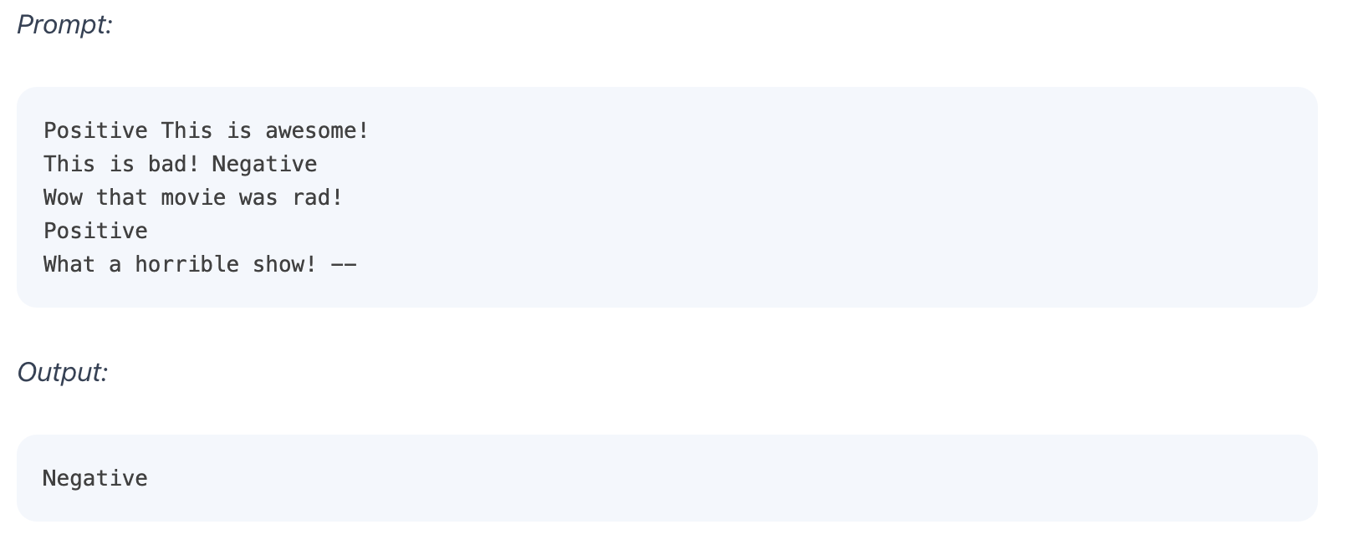
Few-Shot Prompting Examples
63
Notes:
Change low resource IL to a language which is not in wikipedia
Word-level: from bi-lingual dicts and alignment; structure-level comes from wals; multi-level alignment

Slide 64
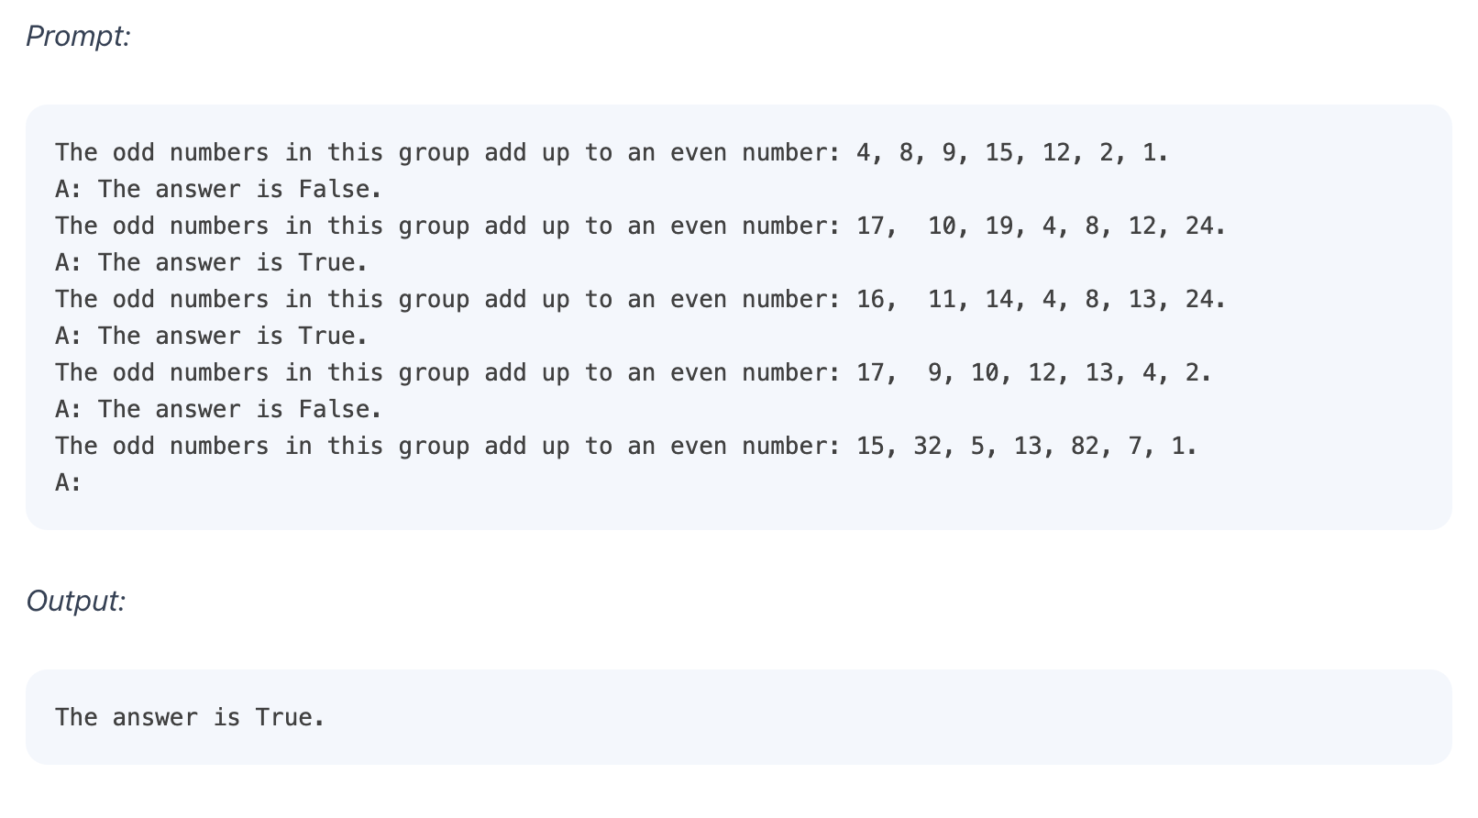
Limitations of Few-Shot Prompting
64
Notes:
Change low resource IL to a language which is not in wikipedia
Word-level: from bi-lingual dicts and alignment; structure-level comes from wals; multi-level alignment

Slide 65
Exercise 1: Social Norm Discovery
What are social norms when meeting people?
E.g., What are social norms when meeting senior people for the first time?
E.g., What are Chinese social norms when meeting senior people for the first time?
E.g., What are American social norms when meeting senior people for the first time?
E.g., What are American social norms when meeting strangers in the elevator?
E.g., What are Chinese social norms when meeting strangers in the elevator?
65
Notes:
Change low resource IL to a language which is not in wikipedia
Word-level: from bi-lingual dicts and alignment; structure-level comes from wals; multi-level alignment

Slide 66
Exercises 2: Event Detection
What types of events are contained in this sentence?
The pro-reform director of Iran's biggest - selling daily newspaper and official organ of Tehran's municipality has stepped down following the appointment of a conservative as the city's new mayor, press reports said Sunday.
66
Notes:
Change low resource IL to a language which is not in wikipedia
Word-level: from bi-lingual dicts and alignment; structure-level comes from wals; multi-level alignment

Slide 67
Exercises 3: Event Participant (Argument) Extraction
Who did what to whom, where and when?
Elliott testified that on April 15, McVeigh came into the body shopand reserved the truck, to be picked up at 4pm two days later. Elliott said that McVeigh gave him the $280.32 in exact change after declining to pay an additional amount for insurance. Prosecutors say he drove the truck to Geary Lake in Kansas, that 4,000 pounds of ammonium nitrate laced with nitromethane were loaded into the truck there, and that it was driven to Oklahoma City and detonated.
67
Notes:
Change low resource IL to a language which is not in wikipedia
Word-level: from bi-lingual dicts and alignment; structure-level comes from wals; multi-level alignment

